Slide 1
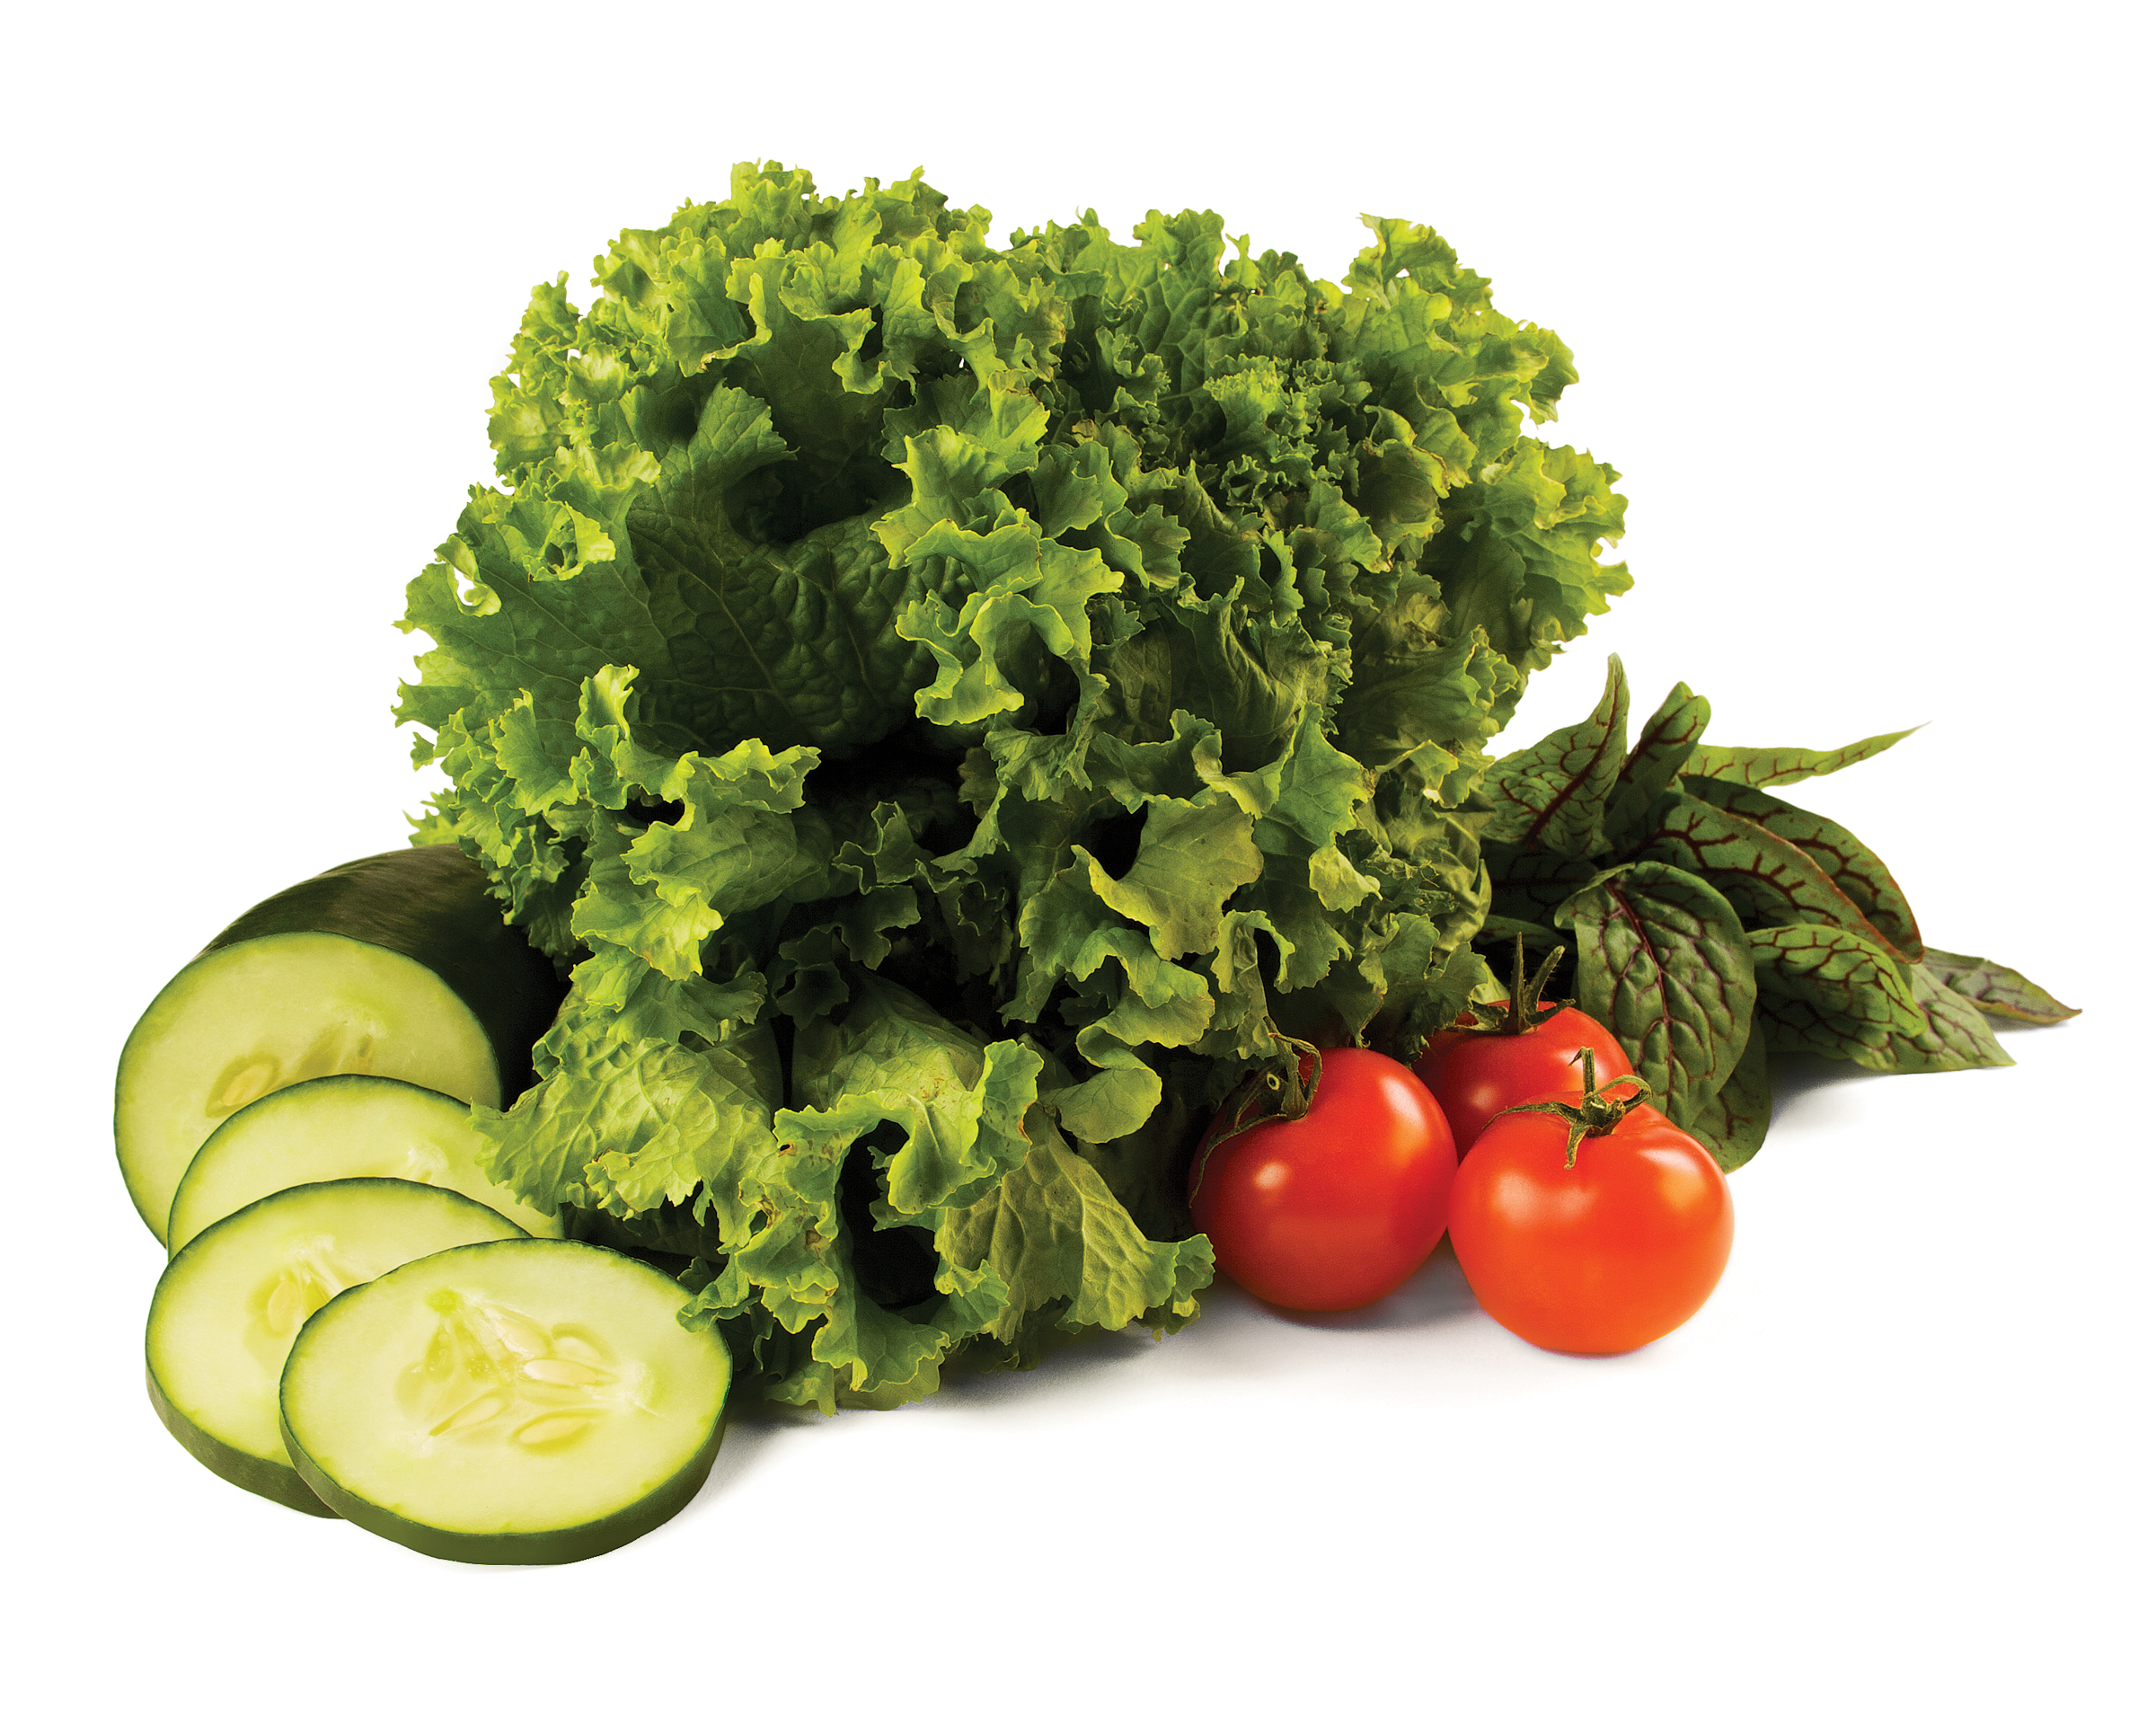
Blood Pressure Self-monitoring program
Dietary approaches to manage hypertension
Healthy Heart Ambassador
© 2015 YMCA of the USA
Notes:
Talking Points
Welcome participants to the Blood Pressure Self-Monitoring Program Nutrition Education Seminar
Introduce yourself and have participants introduce themselves if time and size of group allow
Share that today’s seminar will be on the DASH (Dietary Approaches to Stopping Hypertension) Diet. Hypertension is also known as high blood pressure
Encourage participants to use this opportunity to share ideas and experiences

Slide 2
dash Dietary Approaches to Stop Hypertension
Overview
Nutrition and Blood Pressure Facts
What is DASH?
A Day with the DASH
Choosing the healthy option
Why following DASH works
Notes:
Review the topics of today’s seminar

Slide 3
nutrition & blood pressure
Notes:
Ask
What have you noticed about foods you eat and how they potentially affect your blood pressure?
What do you think are some of the connections between high blood pressure and what we eat?
Talking Points
During this seminar, we will find out what is and isn’t true

Slide 4
nutrition & Blood pressure
Food has a significant effect on blood pressure
Sodium, saturated & trans fats, & added sugars increase blood pressure
Eating a variety of vegetables & fruits, whole grains, lean protein, nuts & seeds can help control blood pressure
Calorie intake should be balanced (in vs out)
Weight impacts blood pressure
Weight gain increases blood pressure
Weight loss decreases blood pressure
Nutrition Weight Blood Pressure
Notes:
Talking Points
Review the information on the slide
When mentioning calorie intake, explain that “in” refers to calories eaten, while “out” refers to calories burned (both through metabolic activity like keeping your heart pumping and brain working, and through physical activity)
Ask
What are some ways to determine the number of calories we take in and the number we expend? (Listen for track food and physical activity, monitor weight)
Why might it be important for us to know that information? (Listen for better weight management means better blood pressure management.)

Slide 5
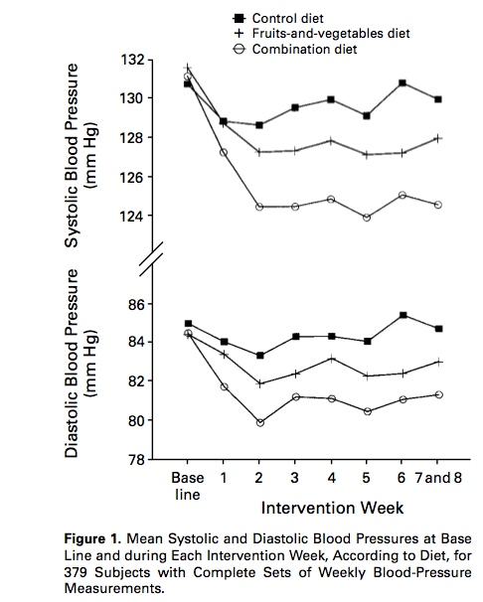
Nutrition & Blood Pressure
Control diet: typical American diet
Fruits-and-vegetables diet: More fruits & vegetables; less snacks & sweets; 75th percentile of U.S. consumption for potassium & magnesium; high fiber
Combination diet: Rich in fruits, vegetables, & low-fat dairy; Reduced saturated fat, total fat, & cholesterol; 75th percentile of U.S. consumption for potassium, magnesium, & calcium; high fiber & protein
(Appel et al., 1997)
Notes:
Talking Points
Let’s talk about how this came about
The DASH Diet has become well established as a model healthy eating plan
The study was supported by the National Heart, Lung and Blood Institute
The original DASH diet didn’t include intentional sodium reduction, but included eating more fruits and vegetables, fiber and foods naturally lower in sodium. The combination diet (the current DASH way of eating) included the healthier eating and a recommendation to reduce sodium to 1,500mg
The foods at the core of the DASH diet are naturally low in sodium. So just by following the DASH way of eating you're likely to reduce your sodium intake. You also reduce sodium further by:
Using sodium-free spices or flavorings with your food instead of salt
Not adding salt when cooking rice, pasta or hot cereal
Rinsing canned foods to remove some of the sodium
Buying foods labeled "no salt added," "sodium-free," "low sodium" or "very low sodium"
Some participants will think you are discussing Mrs. DASH which is a salt substitute product. Make sure they understand that is not the case.
As seen on the graph, those who followed the combination diet had the best results

Slide 6
DASH: Dietary Approaches to Stop hypertension
Notes:
Talking Points
Now we are going to talk about the specifics of the DASH way of eating

Slide 7
What is DASH?
Dietary Approaches to Stop Hypertension
Based on research sponsored by the National Heart, Lung, and Blood Institute (NHLBI)
Reduces the risk of developing cardiovascular disease
Lowers high blood pressure
Improves blood lipid levels
Emphasizes:
vegetables
fruits
fat-free or low-fat dairy
Also includes whole grains, beans, nuts, seeds, vegetable oils
Limits sodium, sweets, sugary beverages, & red meats
Notes:
Talking Points
Review the components of the DASH DIET
If followed, it’s possible to see results quickly - following the DASH diet can reduce your blood pressure by a few points in just two weeks (Mayo Clinic, 2013). Over time, it can make a significant difference in your health risks
Lipids are fats in the blood stream that are also known as cholesterol and triglycerides. (American Heart Association, 2014)

Slide 8
What Is DASH?
Food Group | DASH Emphasis
Vegetables | ⬆
Fruits | ⬆
Grains | Whole grains
Protein | ⬆ Lean meat, Poultry, & Fish ⬇ Red Meat ⬆ Nuts, Seeds, & Beans
Dairy | Low-fat, Fat-free
Oils | Vegetable oils (unsaturated fats)
Sweets | ⬇ Added sugar
Vitamins & Minerals | ⬆Potassium, Magnesium, Calcium ⬇Sodium
Notes:
Talking Points
Here is the simple breakdown of the DASH way of eating
Review slide
Ask
So now that you have seen an overview of the DASH diet, what do you think?

Slide 9
Food Group | Daily Servings | Serving Sizes
Grains | 6-8 | 1 slice bread 1 cup ready-to-eat cereal ½ cup cooked rice, pasta, or cereal
Meats, Poultry, Fish | 6 or less | 3 ounces cooked lean meat, skinless poultry, fish
Vegetables | 4-5 | 1 cup raw leafy veg ½ cup cooked veg 6 ounces vegetable juice
Fruit | 4-5 | 1 medium fruit ¼ cup dried fruit ½ cup fresh, frozen, or canned fruit 6 ounces fruit juice
Low-fat or fat-free dairy products | 2-3 | 8 ounces milk 1 cup yogurt 1 ½ oz cheese
Fats and Oils | 2-3 | 1 tablespoon lowfat mayonnaise 2 tablespoons light salad dressing 1 teaspoon vegetable oil
Sodium | 2,300 mg* | *1,500 mg lowers BP even further
 | Weekly Servings
Nuts, Seeds, Dry Beans, Peas | 4-5 | ½ or 1 ½ ounces nuts 1 tablespoon or ½ ounce seeds ½ cup cooked dry beans
Sweets | 5 or less | 1 tablespoon sugar 1 tablespoon jelly or jam ½ ounce jelly beans 8 ounces lemonade
(NHLBI, 2015)
Notes:
Talking Points
This slide shows a breakdown of daily and weekly food group servings based on a 2,000 calorie a day diet
Review slide
Ask
What are some ways to can incorporate the DASH Diet eating habits into your daily diet? (Listen for: reduce the amount of meat/protein served at a meal and add more veggies-ex have a 3oz hamburger instead of a 5oz hamburger and add more lettuce, tomato, onion, etc., snack on fruit, switch to low-fat or non-fat dairy products. Allow the group to brainstorm ideas.)
What are some changes you can commit to making right away?
How do you see making these changes benefitting you?

Slide 10
Who could benefit from following dash?
People who are at risk for heart disease
High blood pressure
High cholesterol
Diabetes
Chronic kidney disease
Tobacco use
Overweight
Physical inactivity
African Americans
Adults aged 51+
Notes:
Talking Points
People who are at risk for heart disease could benefit from following the DASH diet
Let’s take a look at risk factors (build slide and review)
Ask
Which of these factors do you think are under your control? (Red = risk factors that are within your control)

Slide 11
DASH in A Day
2,300 mg Sodium Menu | To Reduce Sodium to 1,500 mg
Breakfast: ¾ cup bran flakes cereal 1 medium banana 1 cup (8 ounces) low-fat milk 1 slice whole wheat bread 1 teaspoon soft margarine 1 cup (8 ounces) orange juice | ¾ cup shredded wheat cereal 1 teaspoon unsalted soft margarine
Lunch: ¾ cup chicken salad 2 slices whole wheat bread 1 tablespoon Dijon mustard Salad with ½ cup fresh cucumber slices, ½ cup tomato wedges, 1 tablespoon sunflower seeds, 1 teaspoon low calorie Italian dressing ½ cup fruit cocktail | Remove salt from chicken salad recipe 1 tablespoon regular mustard
Dinner: 3 oz beef, eye of the round 2 tablespoons gravy (fat-free) 1 cup green beans, sautéed with ½ teaspoon canola oil 1 small baked potato with 1 tablespoon sour cream (fat-free), 1 tablespoon grated natural cheddar cheese (reduced fat), and 1 tablespoon chopped scallions 1 small whole wheat roll with 1 teaspoon soft margarine 1 small apple 1 cup low-fat milk | 1 tablespoon natural cheddar cheese (reduced fat and low sodium) 1 teaspoon unsalted soft margarine
Snacks: 1/3 cup almonds (unsalted) ¼ cup raisins ½ cup fruit yogurt (fat-free, no sugar added) | (NHLBI, 2015)
(NHLBI, 2003)
Notes:
Talking Points
Let’s look at one day of meals using the DASH way of eating to eat a variety of foods and lower sodium
Activity
Ask participants to partner up and discuss how they can incorporate some DASH eating habits into their diet. After a few minutes ask some of the participants to share their ideas

Slide 12
Choosing the Healthier Option
This or That?
Breakfast
3 egg Omelet with spinach, tomatoes, feta cheese, & English muffin with a cup of orange juice
Fat-free yogurt with strawberries, blueberries, sliced bananas, oats, & almonds with water
Lunch
Spinach & whole grain pasta salad with chicken, walnuts, avocado, tomatoes, & reduced fat goat cheese with a cup of water
Tomato, mozzarella, & basil sandwich on Ciabatta bread with water
Dinner
Teriyaki Beef & Vegetable stir-fry with white rice with water
Salmon with broccoli, & brown rice with a cup of skim milk
Notes:
Talking Points
Now we are going to look at some sample meals and talk about which ones are the healthier options and how we can improve some of the unhealthier options
Activity
Ask participants to partner up. Ask them to look at each of the meals and determine which is the healthier option. Allow 5 minutes then return to larger group.
Ask
What makes one meal healthier than the other for each meal of the day? (Listen for fresh fruit, reduced fat cheese, no sauce)
How might we improve some of the unhealthier options?
Breakfast: 1 egg omelet with spinach, tomatoes, reduced fat cheese, whole wheat toast and water
Lunch: Tomato, reduced fat mozzarella and basil sandwich on whole wheat bread with an apple and water
Dinner: Chicken and vegetable stir fry made with low sodium soy sauce (<300 mg/Tbsp) or low sodium homemade sesame ginger sauce, brown rice and a cup of low fat or skim milk
Before Advancing Slide Ask
Why do you think following DASH works? (check for understanding)

Slide 13
Why Following DASH works
Promotes a wholesome & healthy lifestyle
Well balanced meals
Follows the Dietary Guidelines for Americans
Helps to regulate & reduce blood pressure
Increased potassium, calcium, magnesium, fiber, & protein
Reduced sodium, added sugars, saturated & trans fats
Promotes healthy weight loss and/or maintenance
Replaces empty-calorie foods with nutrient-dense foods
Notes:
Talking Points
Because the DASH diet is a healthy way of eating in general, it offers benefits besides just lowering blood pressure. It can help prevent a variety of chronic diseases.
While it is not a weight-loss program, it can steer you towards a healthier diet and help you naturally lose some unwanted pounds.

Slide 14
discussion
Notes:
Divide the group into smaller subgroups. Ask each group to discuss the questions on the next slide

Slide 15
Discussion
After having discussed DASH, think about what you have eaten today…
What foods have you eaten today that would be DASH friendly?
How could you make your food choices more similar to the DASH approach to eating?
Think about the kinds of DASH foods you can purchase at the grocery store or at a restaurant or convenience store…
What are some of the foods that you might be tempted to buy and why?
What kinds of foods can you buy on a budget that would contribute to a DASH approach to eating?
When you have a busy day and are constantly on the go, what kinds of foods do you tend to eat?
How are they prepared?
How might food preparation come into play when following DASH?
Notes:
Walk around and encourage/facilitate discussion and shared learnings in their small groups. Keep it all about the group and the participants’ ideas
After discussion bring group back together and debrief learning
Ask
What are some of the ideas that came from your discussions?
What are some changes you feel prepared to make right away?
What are some challenges you might face?
What are some ways you can work around potential challenges to make healthier changes?

Slide 16
Physical activity and blood pressure management
Notes:
Talking Points
We’ve talked about the DASH way of eating and the benefits it can have in helping lower blood pressure and reducing risks of heart disease. Now we’re going to take a look at how adding or increasing physical activity can also help

Slide 17
Physical Activity and blood pressure management
Evidence has shown that regular physical activity can lead to a significant reduction in blood pressure and improve other cardiovascular risks
Moderate physical activity has also been proven to decrease blood pressure in hypertensive patients who are less responsive to medical treatment
30 minutes of physical activity a day (equivalent to brisk walking) 6-7 days each week (180 minutes each week) may result in better management or a reduction in one’s blood pressure
Notes:
Talking Points
Review slide
Emphasize that physical activity should be the equivalent of a brisk walk
Ask
What are some ways you can add physical activity to your day?

Slide 18
Physical Activity and blood pressure management
Resources to support this claim include, but are not limited to:
"Exercise in Resistant Hypertension: Aerobic Exercise Reduces Blood Pressure in Resistant Hypertension." Hypertension. 2012
"Hypertension." Exercise Testing and Exercise Prescription for Special Cases: Theoretical Basis and Clinical Application. 2005
"Regular Aerobic Exercise Augments Endothelium-Dependent Vascular Relaxation in Normotensive As Well As Hypertensive Subjects" Circulation. 1999
"The effects of aerobic exercise and T'ai Chi on blood pressure in older people: results of a randomized trial." Journal of the American Geriatrics Society. 1999

Slide 19
Thank You
Name
YMCA OF THE USA
800 872 9622
name.name@ymca.net
Notes:
Talking Points
Do a quick debrief of their takeaways from today’s session
Pass out DASH Fact Sheet and Lowering Your Blood Pressure with DASH Handouts
Share information on upcoming Nutrition Education Seminars
Remind participants to self-monitor and track their blood pressure at home and attend office hours
A Healthy Heart Ambassador is there to help participants practice self-measuring. Encourage participants to connect with the Healthy Heart Ambassador to practice self-measuring and ask questions, before they leave

