Slide 1
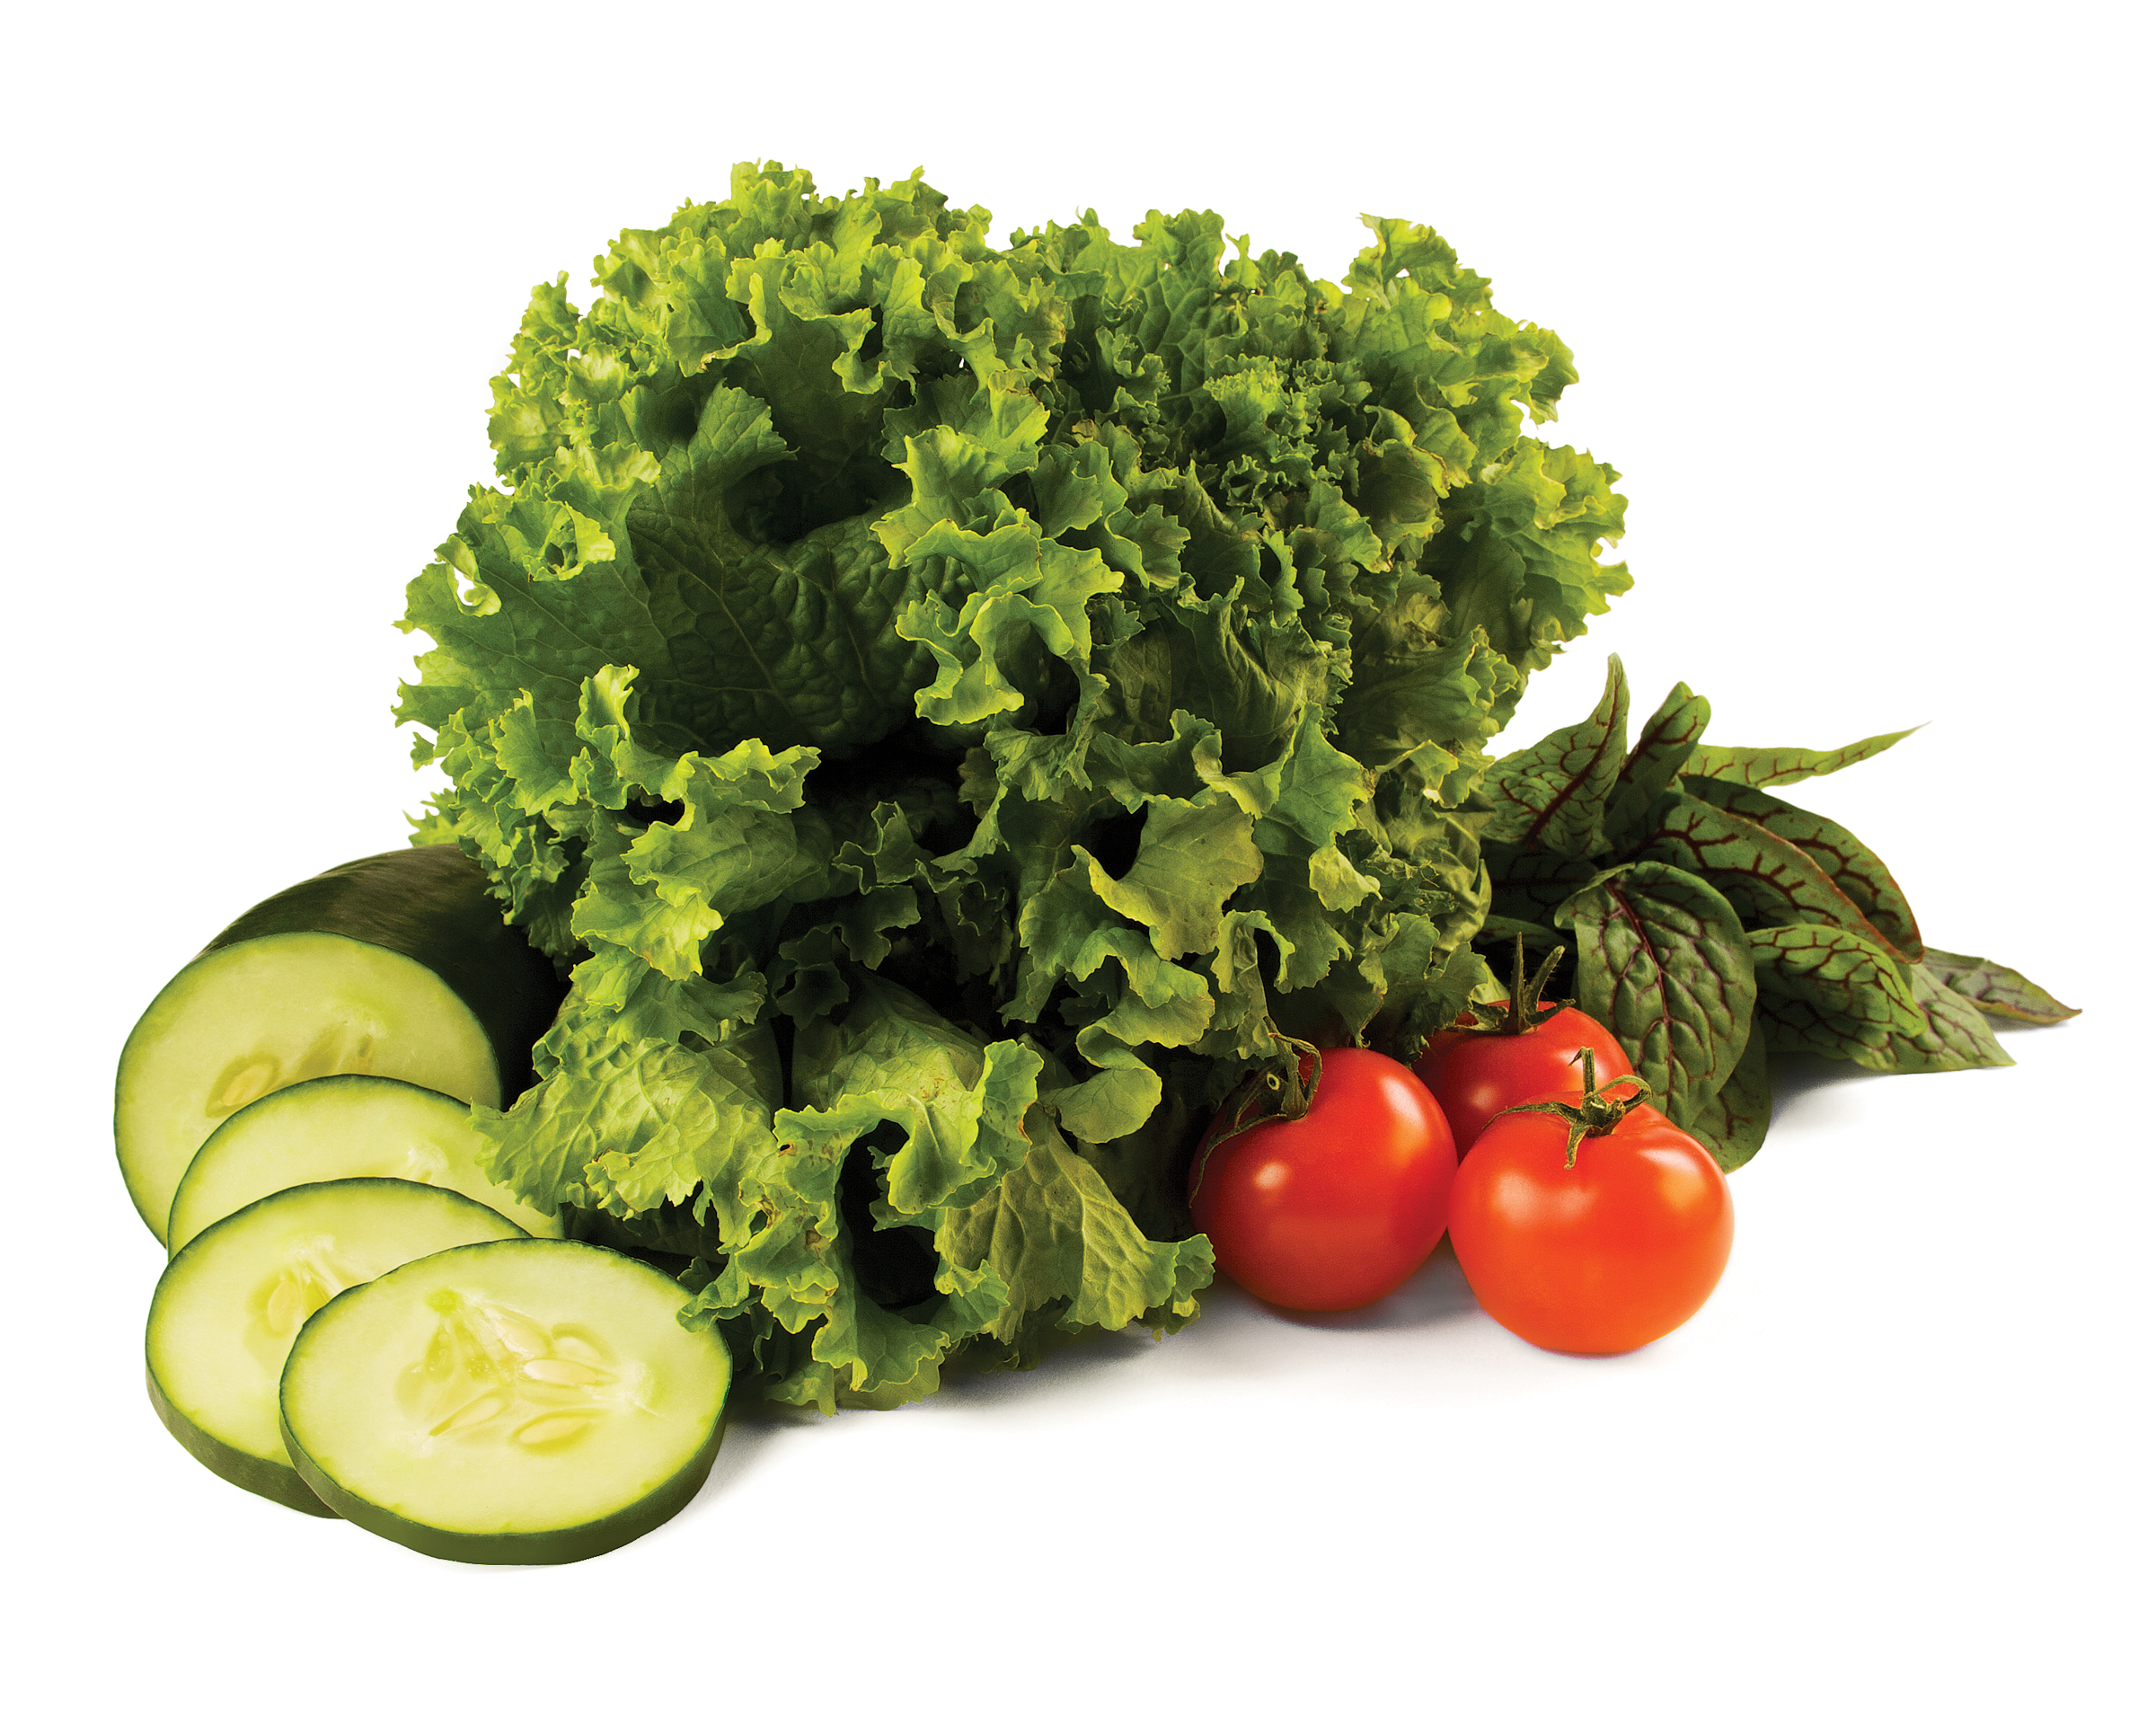
Blood Pressure Self-monitoring program
Shopping, preparing and cooking food
for better blood pressure management
© 2015 YMCA of the USA
Notes:
Talking Points
- Welcome participants to the Blood Pressure Self-Monitoring Program Nutrition Education Seminar
- Introduce yourself
- These nutrition seminars address various ways of eating that we should be mindful of to stay healthy and effectively manage blood pressure
- Share that today’s seminar will be on shopping, preparing and cooking food for better blood pressure management
- Encourage participants to use this opportunity to share ideas and experiences

Slide 2
Shopping, preparing & cooking food for better blood pressure management
Overview
Nutrition and Blood Pressure Facts
Food labels and shopping for blood pressure friendly foods
How to prepare and cook food for better blood pressure management
Salts, Herbs and Spices
Notes:
Talking Points
- Review the topics of today’s seminar

Slide 3
Nutrition & blood pressure
Notes:
Talking Points
- Nutrition choices have a direct impact on blood pressure

Slide 4
nutrition & Blood pressure
Eat a variety of nutritious foods from all the food groups
Fruits and vegetables
Whole grains
Low-fat dairy products
Poultry, fish, lean meats and nuts
*Choose foods low in sodium, saturated and trans fats
Look for the heart-check mark
The American Heart Association developed the heart-check mark. When you see this symbol on food packaging, it means that the product meets the American Heart Association's criteria for saturated fat, trans fat, sodium, cholesterol, and important nutrients for a single serving of the food product for healthy people over age 2.
(AHA, 2015)
Notes:
Talking Points
- Review slide
- Taking steps to eat a healthy diet can provide long term benefits to your health and your heart
- It’s recommended that you eat a variety of foods from all of the food groups
- Look for the American Heart Association heart-check mark to see if the foods you are eating meet the American Heart Association criteria for saturated fat, trans fat, sodium, cholesterol, and important nutrients.
Ask
- How are you doing eating a variety of foods from all food groups?
- What are some changes you might need to make?

Slide 5
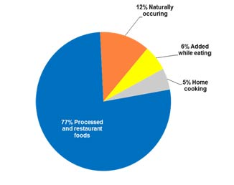
nutrition & Blood pressure
Common sources of dietary sodium found in food supply in the American diet
Virtually all Americans consume too much sodium
Sodium intake should stay between 1,500 – 2,400 mg/day
The average sodium intake for an American is 3,400 mg/day
(CDC 2015, USDA 2015)
Notes:
Talking Points
- The foods we choose can have a big impact on the amount of sodium we consume
- Only 11% of the salt in our food comes from what we add
- 77% of the salt we consume is added to food during processing. This makes it difficult for individuals to reduce salt intake on their own if they consume a high amount of processed foods
Ask
- What are some strategies you might want to keep in mind as you think about planning, shopping and cooking meals? Listen for: planning ahead, making a list, eating fewer processed food

Slide 6
Shopping for blood pressure friendly foods
First, plan meals → make a list
Do not shop on an empty stomach
Buy fresh
Shop around the perimeter of store
Look at labels
Buy fresh, plain frozen, or canned with “no added salt” vegetables
Buy fresh poultry, fish, and lean meat, rather than canned or processed types
Choose “convenience” foods that are low in sodium
Choose ready-to-eat breakfast cereals that are low in sodium
(NHLBI, 2015; Mayo Clinic, 2015)
Notes:
Talking Points
- Planning meals and making a list can help prevent you from straying from the list
- If you eat before you shop, you will be less likely to buy higher fat and higher sodium foods
- Fresh foods contain more vitamins, minerals and fiber than their packaged counterparts. If you buy convenience foods, make sure they are a low-fat, low-sodium option
- Stick to the perimeter of the store where you’ll find fresh fruits and vegetables, low-fat dairy and lean meats. The center aisles offer a lot of processed high-sodium, high-fat packaged foods
- Cut back on frozen dinners, pizza, packaged mixes, canned soups or broths and salad dressing. These often have a lot of sodium
- Many ready to eat cereals have a lot of sodium in them, so be mindful
Ask
- What do you think about these strategies?
- Which ones would be most helpful for you to use?

Slide 7
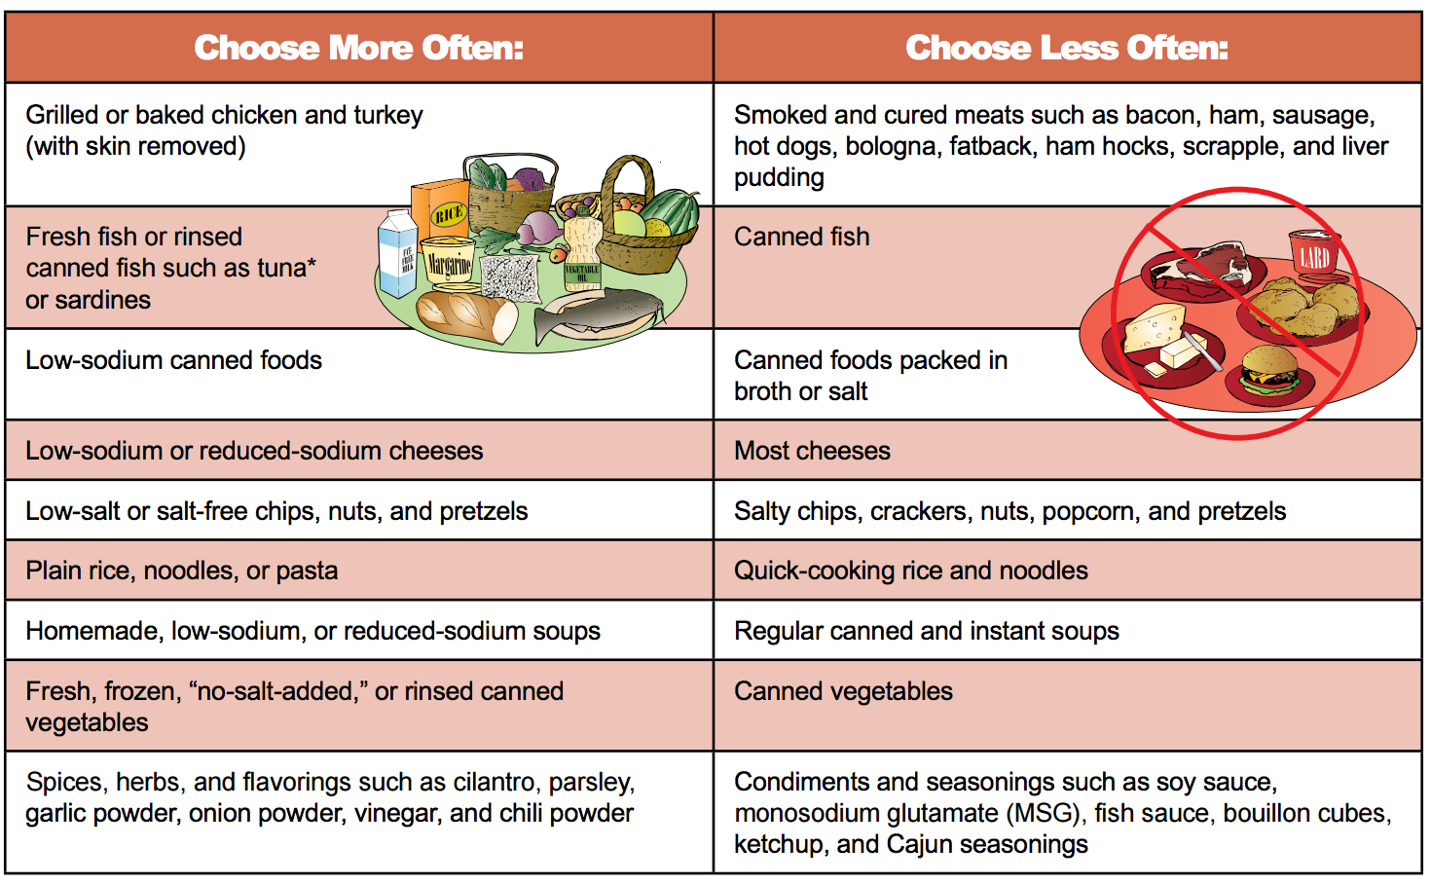
Shopping for blood pressure friendly foods
(NHLBI, 2013
Notes:
Talking Points
- Review slide
Ask
- How do you feel about making some of these changes?

Slide 8
Shopping for blood pressure friendly foods
By adopting the habit of reading food labels, you can choose foods more wisely.
Watch for foods that have high levels of saturated fat or trans fat, or that include hydrogenated fat – these can all raise your cholesterol.
Watch for foods high in sodium - these can increase blood pressure.
On average, the higher your salt intake, the higher your blood pressure.
When reading labels, watch for these key terms, and know what they mean.
Free
Very Low and Low
Reduced or Less
(AHA, 2014; USDA 2008)
Notes:
Talking Points
- Americans eat 30% more packaged food than fresh food, and consume more packaged food than individuals living in nearly all other countries
- It’s important to read the food label and determine the sodium content of food, which can vary by several hundreds of milligrams in similar foods. For example, the sodium content in regular tomato soup may be 700 mg per cup in one brand and 1,100 mg per cup in another brand
- Reading labels, comparing sodium contents of foods and then purchasing the lower sodium brand may be one strategy to lower sodium intake
- It’s important to understand different statements and claims on labels, in order to have a clear understanding of what you are buying
- Free-examples: cholesterol free, fat free, dairy free. If you are looking to avoid a certain dietary element, then “free” is the best choice
- Very Low and Low-examples: very low sodium, low fat, low cholesterol. “Very Low” and “Low” may be helpful if you are looking to reduce a certain element
- Reduced or Less-example: reduced carbs, less sugar, reduced fat. These terms mean the food has 25% less of that nutrient than the reference, or standard, version of that food. So if you see “reduced sugar” peanut butter, it means this version has at least 25% less sugar than its standard counterpart
- It’s still a good idea to check the food label to see exactly how much of each component (fat, sodium, cholesterol, sugar, etc.) is in the product

Slide 9
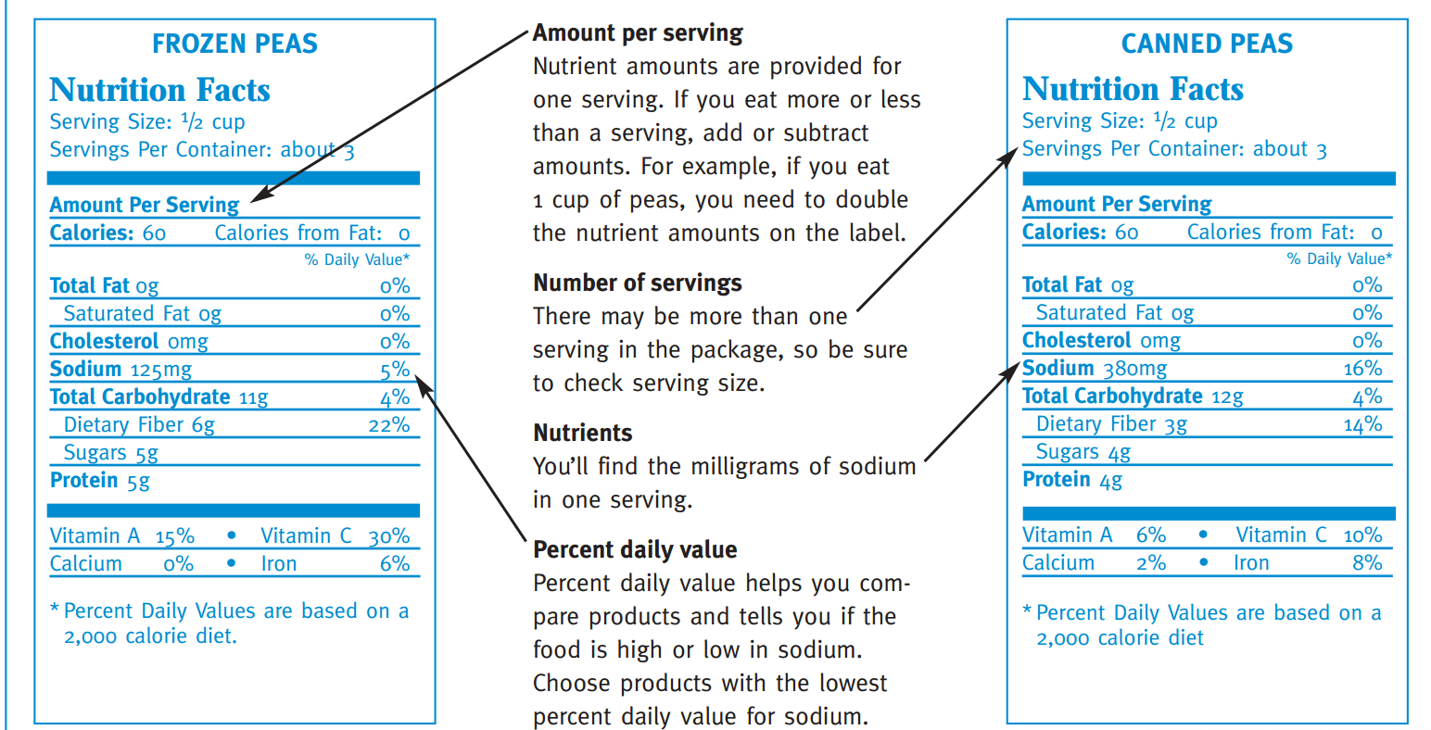
Shopping for blood pressure friendly foods
Food Labels: Frozen vs. Canned
Notes:
Talking Points
- Review the components of the nutrition facts label, emphasizing the value of reading them
- Become a detective and use food labels as your clues
Ask
- What do you notice when you compare these two labels? Listen for: frozen peas have lower sodium than canned peas. Canned peas have 3 times more sodium

Slide 10
Shopping for blood pressure friendly foods
Food Labels: Which cereal is a heart healthier choice?
Notes:
Ask
- Which cereal is a heart healthier choice? Listen for: Mixed Berry
- Why is it the healthier choice? Listen for: less calories, sodium and sugar and more protein, potassium, vitamins and minerals
Talking Points
- Protein keeps you full longer and potassium is important for reducing blood pressure

Slide 11
Food Preparation for better blood pressure management
Flavor your foods with salt-free seasoning blends, fresh or dried herbs and spices, or fresh lemon and lime juice.
Cook rice, pasta, and hot cereal without salt
Rinse canned foods, such as tuna and beans, to remove some sodium
Remove the salt shaker from the prep area and dinner table
(NHLBI, 2015)
Notes:
Talking Points
- Once you’ve shopped for your food, it’s time to think about how you prepare it
- There are many ways you can prepare healthy food that’s low in sodium, without losing any flavor
- Review slide

Slide 12
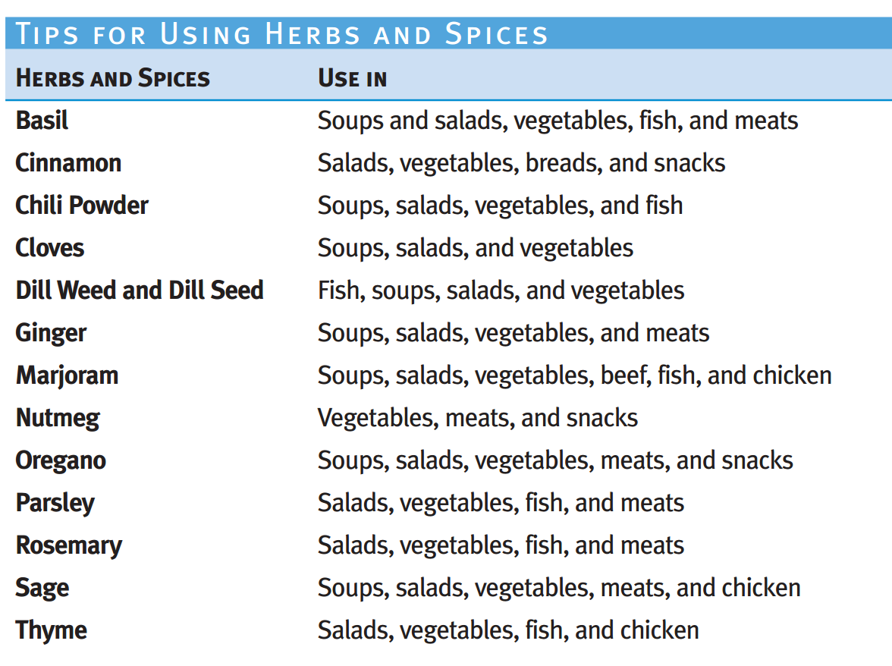
Cooking for better blood pressure management
How can we use herbs and spices in foods we eat everyday?
(NHLBI, 2013)
Notes:
Talking Points
- Many herbs and spices are very versatile, so you can use them in many different dishes
- Review slide
Ask
- Has anyone used any of these, or other herbs or spices in a dish recently? If so, what was the dish?
Facilitator Note: Here is a link to a helpful handout to use:
https://www.nhlbi.nih.gov/health/educational/healthdisp/pdf/tipsheets/use-herbs-and-spices-instead-of-salt.pdf

Slide 13
Cooking for better blood pressure management
What are some other things you can do at home to reduce your sodium intake?
Substitute butter and oil with water or low-sodium broths for sautéing
Use lower fat substitutions in recipes
Use reduced-fat and low sodium condiments when available
Substitute mayonnaise or sour cream with Greek yogurt or cottage cheese
Substitute fatty meats with beans and other veggies in recipes
(Mayo Clinic, 2014)
Notes:
Talking Points
- Review slide
- If you do not want to add any sodium at all, use a little bit of healthy oil to sauté, instead of the broth
- Don’t be afraid to modify your recipes if they call for a lot of fat and salt
- Make substitutions and experiment with herbs and spices to create something new

Slide 14
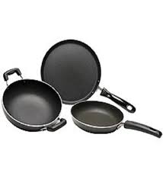
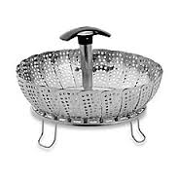
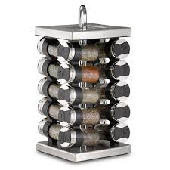
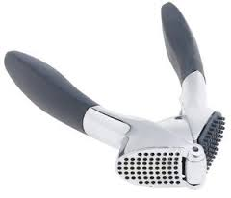
Cooking for better blood pressure management
Cooking Tools
Non-stick cookware
Vegetable steamer insert
Spice turn-table or garlic press
(Mayo Clinic, 2014)
Notes:
Talking Points
- Non-stick cookware allows you to cook without adding butter or other added fat
- Vegetable steamer inserts allow you to cook vegetables without adding fat. Steaming vegetables helps retain the vitamins and minerals
- Having a spice turntable and/or a garlic press may make it easier to prepare foods with spices and herbs than with a salt shaker

Slide 15
Activity Recipe Makeover
Notes:
Talking Points
- Let’s practice some of the new strategies you’ve learned, by making over a recipe

Slide 16
Recipe makeover: Taco Pizza
Let’s look at a common recipe for taco pizza
Can you identify 5 modifications that can be made to create a healthier version of taco pizza?
Items to consider:
Ground beef
Packaged taco seasoning mix
Pillsbury crescent rolls
Canned refried beans
Standard shredded cheese
Canned black olives
Taco Pizza Recipe
1 lb. ground beef
1 envelope taco seasoning mix
2 (8 oz.) cans Pillsbury crescent rolls
1 (16 oz.) can refried bean
2-3 cups shredded cheddar cheese or Mexican blend
½ cup chopped tomatoes
¼ cup sliced black olives
4 green onions, chopped
Notes:
Activity Instructions
- Have the participants get into groups (or they can work individually) and have them create a healthier, DASH friendly version of the Taco Pizza
- Have each group report out on some of the modifications that can be made. See if the whole group can identify at least 5 changes that can be made
Advance to next slide to reveal possible modifications
-Have the participants get into groups or they can work on it individually and have them create a healthier DASH friendly version of the taco pizza.
Have each group report out what are some modifications that can be made? See if the group can identify at least 5 changes that can be made.
-Canned refried beans are VERY high in sodium. It is better to make your own unless you can find a low-sodium version.
Refried Beans Instructions:
Heat the olive oil over medium heat in a skillet.
Add the onion, garlic, and peppers if you are using them. Cook for 4-5 minutes until onion begins to soften.
Add the beans and broth. Cook for about 5 minutes until beans are warm.
Recipe at: http://www.slenderkitchen.com/quick-refried-beans/#

Slide 17
Recipe makeover: Taco Pizza
Original Recipe | Modified Recipe
1 lb. ground beef | 1 lb. lean ground turkey
1 envelope taco seasoning mix | 1 envelope reduced sodium taco seasoning mix (tip: use half the seasoning packet)
2 (8 oz.) cans Pillsbury crescent rolls | 2 (8 oz.) cans reduced fat Pillsbury crescent rolls
1 (16 oz.) can refried bean | Make your own refried beans (olive oil, onion, garlic, peppers, 1 can pinto beans, low-sodium broth)
2-3 cups shredded cheddar cheese or Mexican blend | 2-3 cups reduced fat shredded cheddar cheese (or any other reduced fat shredded cheese)
½ cup chopped tomatoes | ½ cup chopped tomatoes
¼ cup sliced black olives | ¼ cup sliced black olives (rinsed, drained)
4 green onions, chopped | 4 green onions, chopped
Notes:
Talking Points
- Review modifications
- Refried beans are very high in sodium. It is better to make your own unless you can find a low-sodium version
- You can also always increase the tomatoes and onions

Slide 18
Discussion

Slide 19
Discussion
Think about how you currently prepare to shop for food…
Do you plan meals for the week ahead of time?
Do you make a grocery item list?
What items can you substitute to make your choices more blood pressure friendly? (salts vs. herbs & spices; salted vs. unsalted foods and snacks; reduced sodium; canned vs. frozen)
Think about how you currently prepare your food at home…
Do you use fresh ingredients?
What blood pressure friendly techniques would you consider using moving forward?
What are some of your favorite recipes?
Which ingredients may contribute to higher blood pressure?
How can the recipe be modified to be more blood pressure friendly?
Notes:
Talking Points
Facilitate group discussion with questions on the slide

Slide 20
Physical activity and blood pressure management

Slide 21
Physical Activity and blood pressure management
Evidence has shown that regular physical activity can lead to a significant reduction in blood pressure and improve other cardiovascular risks
Moderate physical activity has also been proven to decrease blood pressure in hypertensive patients who are less responsive to medical treatment
30 minutes of physical activity a day (equivalent to brisk walking) 6-7 days each week (180 minutes each week) may result in better management or a reduction in one’s blood pressure
Notes:
Talking Points
- Review slide
- Emphasize physical activity should be the equivalent of a brisk walk
Ask
- What are some other potential benefits to working towards 180 minutes of physical activity a week?
- What are some ways you can add physical activity to your day?

Slide 22
Physical Activity and blood pressure management
Resources to support this claim include, but are not limited to:
"Exercise in Resistant Hypertension: Aerobic Exercise Reduces Blood Pressure in Resistant Hypertension." Hypertension. 2012
"Hypertension." Exercise Testing and Exercise Prescription for Special Cases: Theoretical Basis and Clinical Application. 2005
"Regular Aerobic Exercise Augments Endothelium-Dependent Vascular Relaxation in Normotensive As Well As Hypertensive Subjects" Circulation. 1999
"The effects of aerobic exercise and T'ai Chi on blood pressure in older people: results of a randomized trial." Journal of the American Geriatrics Society. 1999

Slide 23
Thank You
Notes:
Talking Points
- Do a quick debrief of their takeaways from the session and changes they will make in their shopping, preparing and cooking of food
- Pass out handouts: How Do I Modify Recipes, Low Sodium Foods Shopping List
- Share information on upcoming Nutrition Education Seminars
- Remind participants to self-monitor and track their blood pressure at home and attend office hours

