Slide 1
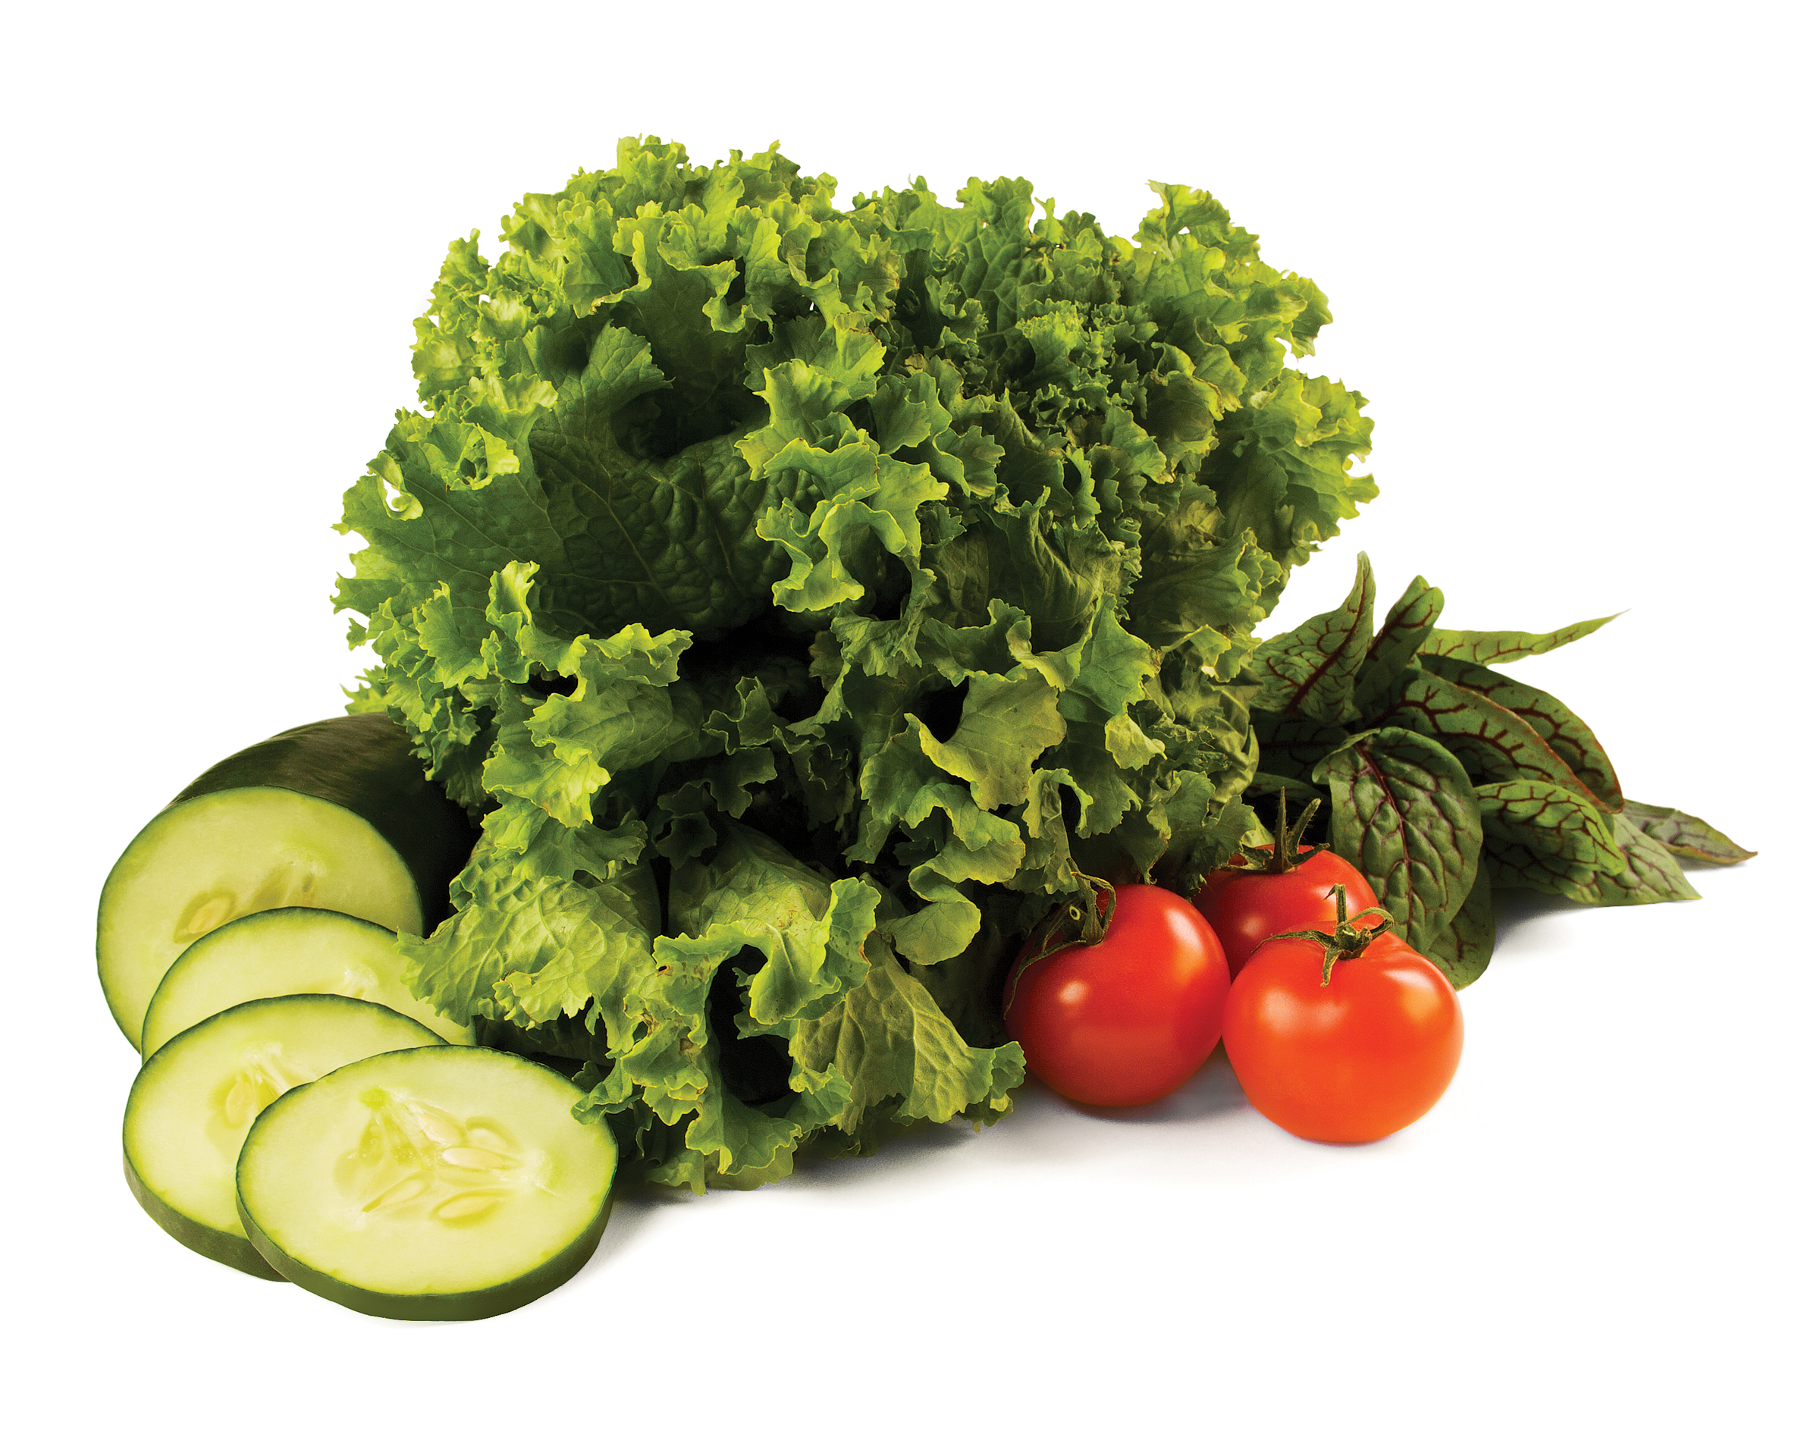
Blood pressure Self-Monitoring program
Heart Healthy Eating for Life
© 2015 YMCA of the USA
Notes:
Talking Points
Welcome participants to the Blood Pressure Self-Monitoring Program Nutrition Education Seminar
Introduce yourself
These nutrition seminars address various ways of eating that we should be mindful of to stay healthy and effectively manage blood pressure
Share that today’s seminar will be on heart healthy eating for life
Encourage participants to use this opportunity to share ideas and experiences

Slide 2
Heart Healthy Eating for Life
Overview
Nutrition and Blood Pressure Facts
Fats & Oils
Vitamins & Minerals
Healthy Snacks
Dining Out
Notes:
Talking Points
Review the topics of today’s seminar
Nutrition and Blood Pressure Facts
Fats & Oils
Vitamins & Minerals
Healthy Snacks
Dining Out

Slide 3
Nutrition & blood pressure
Notes:
Talking Points
Our food choices impact our blood pressure. We need to consider nutrition as a part of a healthy lifestyle that keeps our blood pressure well managed

Slide 4
nutrition & Blood pressure
Eating for a healthy heart is a key factor in the fight to prevent cardiovascular disease
Eating a variety of fruits and vegetables may help manage weight, cholesterol and blood pressure
A healthy dietary pattern emphasizes:
Fruits and vegetables
Whole grains
Low-fat dairy products
Skinless poultry and fish
Nuts and legumes
Non-tropical vegetable oils
Limiting salt or sodium, saturated fat, trans fat, and sweets in your diet can also lower your blood pressure
A healthy eating pattern can be adapted based on your cultural and food preferences and for medical conditions such as diabetes
(AHA, 2015)
Notes:
Talking Points
Eating for a healthy heart is a key factor in the fight to prevent cardiovascular disease (which includes coronary heart disease, stroke and heart failure)
Review slide
Eating a variety of fruits and vegetables may help manage weight, cholesterol and blood pressure
A healthy dietary pattern emphasizes
Fruits and vegetables
Whole grains
Low-fat dairy products
Skinless poultry and fish
Nuts and legumes
Non-tropical vegetable oils
Limiting salt or sodium, saturated fat, trans fat and sweets in your diet can also lower your blood pressure
A healthy eating pattern can be adapted based on your cultural and food preferences and for medical conditions such as diabetes
Taking steps to eat a healthy diet can provide long term benefits to your health and your heart
It’s recommended that you eat a variety of foods from all of the food groups
Look for the American Heart Association heart-check mark to see if the foods you are eating meet the American Heart Association criteria for saturated fat, trans fat, sodium, cholesterol, and important nutrients

Slide 5
Recommended daily servings
Food Group | 1,600 Calorie Diet | 2,000 Calorie Diet | Examples of One Serving
Grains At least half of your servings should be whole-grain. | 6 servings per day | 6-8 servings per day | 1 slice bread 1 oz dry cereal (check nutrition label for cup measurements of different products) 1/2 cup cooked rice, pasta, or cereal (about the size of a baseball)
Vegetables Eat a variety of colors and types | 3-4 servings per day | 4-5 servings per day | 1 cup raw leafy vegetables (about the size of a small fist) 1/2 cup cut-up raw or cooked vegetables 1/2 cup vegetable juice
Dairy Fat-free or low-fat dairy products | 2-3 servings per day | 2-3 servings per day | 1 cup fat-free or low-fat milk 1 cup fat-free or low-fat yogurt 1 and 1/2 oz fat-free or low-fat cheese (about the size of 6 stacked dice)
Lean meats, poultry, and fish | 3-6 oz (cooked) per day | Less than 6 oz per day | 3 oz cooked meat (about the size of a computer mouse) 3 oz grilled fish (about the size of a checkbook)
Fats and oils | 2 servings per day | 2-3 servings per day | 1 tsp soft margarine 1 Tbsp mayonnaise 1 tsp vegetable oil 1 Tbsp regular or 2 Tbsp low fat salad dressing
Nuts, seeds, and legumes | 3-4 servings per week | 4-5 servings per week | 1/3 cup or 1 and 1/2 oz nuts 2 Tbsp. peanut butter 2 Tbsp. or 1/2 oz seeds 1/2 cup dry beans or peas
Sweets and added sugars | 0 servings per week | 5 or fewer servings per week | 1 Tbsp. sugar 1 Tbsp. jelly or jam 1/2 cup sorbet and ices 1 cup lemonade
(AHA, 2015)
Notes:
Talking Points
We need to think about a lifestyle that promotes a healthy heart and includes a variety of foods. This slide breaks down a day into the recommended servings
Review slide
Aim for the recommended servings to ensure your body is consuming all of the minerals and vitamins it needs to be heart healthy
Ask
What do you notice about the categories?
Does it look like a variety of foods?
Think about a typical day. How are you doing meeting the recommended daily servings and eating a variety of foods?

Slide 6
Sodium
Most Americans eat too much sodium, which increases their risk for high blood pressure, heart disease and stroke
Most of this sodium (over 75%) comes from processed and restaurant foods
Read nutrition labels!
Eat more servings of fruits and vegetables each day: a diet rich in fresh and frozen fruits and vegetables can help lower blood pressure
Eat out less, cook more at home: one restaurant meal can add up to more than one day’s worth of sodium
Limit salty foods: common foods high in sodium include breads and rolls, cured meats, pizza, poultry, soups, sandwiches, cheese, pasta dishes and snacks
(CDC, 2015)
Notes:
Slide Builds
It’s important to remember to look for ways to reduce sodium intake for healthy heart eating
Most Americans eat too much sodium, which increases their risk for high blood pressure, heart disease and stroke
Most of the sodium (75%) comes from processed and restaurant foods
You can monitor your sodium intake by doing the following:
Read nutrition labels
Eat more servings of fruits and vegetables each day
Eat out less, cook more at home
Limit salty foods
Ask
What are some ways you are working to reduce sodium?

Slide 7
Fats and Oils
Do we need fats and WHY?
Dietary fats are essential
Fats give your body energy and support cell growth
Fats protect your organs and keep your body warm
Fats help your body absorb nutrients and produce important hormones
How many different fats are there?
4 major types:
Saturated fat
Trans fat
Monounsaturated fat*
Polyunsaturated fat; omega-3*
* Heart Healthy Fats
(AHA, 2015)
Notes:
Talking Points
Review Slide
Fats have different effects on the cholesterol levels in your body:
Saturated fats and trans fats raise LDL cholesterol (“lousy” cholesterol). These types of fats are solid at room temperature
Monounsaturated fats and polyunsaturated fats can help lower LDL cholesterol levels, which is beneficial to heart health. These fats are liquid at room temperature
Research has shown that omega-3 fatty acids decrease the risk of arrhythmias (abnormal heartbeats), decrease triglyceride levels, slow the growth rate of atherosclerotic plaque and can slightly lower blood pressure

Slide 8
Fats and Oils
Identifying fats and oils
⬇ Saturated fat: fatty beef, lamb, pork, poultry with skin, beef fat (tallow), lard and cream, butter, cheese, and other dairy products made from whole or reduced-fat (2%) milk, palm oil, coconut oil
⬇ Trans fat: “partially hydrogenated oils” in processed foods such as doughnuts, baked goods including cakes, pie crusts, biscuits, frozen pizza, cookies, crackers, and stick margarines and other spreads
⬆ Monounsaturated fat: Oils → canola, peanut, safflower, and sesame oil, and avocados
⬆ Polyunsaturated fat: Oils → soybean, corn, and sunflower, and fatty fish such as salmon, mackerel, herring and trout
⬆ Omega-3: Nuts, seeds, fatty fish such as salmon, mackerel, herring, lake trout, sardines and albacore tuna
(AHA, 2015)
Notes:
Talking Points
Let’s take a look at examples of different fats
There are many sources of fat, so your diet can include a variety of foods to meet your dietary fat needs
Review slide: emphasize decreasing saturated and trans fat and increasing monounsaturated fat, polyunsaturated fat and omega-3’s.

Slide 9
Vitamins and minerals
Several vitamins and minerals are critical to heart health
Vitamin E
Nuts, seeds, cooking oils
Vitamin D
Sunlight, milk, cereal
Potassium
Lean meats, fish, citrus fruits and citrus juice, potatoes, lima beans, tomatoes, spinach, mushrooms, cantaloupe, fat-free or low fat dairy products
Magnesium
Nuts, beans, spinach, peanut butter, halibut, potatoes, avocados
(USDA, 2014)
Notes:
Talking Points
Several vitamins and minerals are critical to heart health
Studies show a diet rich in vitamin E produces a reduction of more than 40 percent in the risk of stroke, heart attack and heart disease. Vitamin E is found in nuts, seeds and cooking oils
The Cleveland Clinic reports that vitamin D helps treat diabetes and cancer, build strong bones and prevent heart disease. You can get vitamin D from sunlight, milk and cereal
One of the primary benefits of potassium is its ability to lower blood pressure, which can in turn help lower the risk of heart disease. One report in the March 15, 2011 issue of “Current Hypertension Reports,” states that intakes of potassium in amounts of 4,700 mg per day can lower blood pressure and reduce the risk of heart attack and stroke by 8 to 15 percent. This is also the amount of daily potassium recommended in the DASH way of eating. Sources of potassium include lean meats, fish, citrus fruits and citrus juice, potatoes, lima beans, tomatoes, spinach, mushrooms, cantaloupe and fat free or low fat dairy products
Magnesium is an essential mineral that has an effect on the heart. The National Institutes of Health reports that magnesium maintains blood pressure and proper heart rhythm by keeping the muscles functioning properly. Nuts, beans, spinach, peanut butter, halibut, potatoes and avocados are sources of magnesium

Slide 10
Vitamins and minerals
WHY an emphasis on potassium?
Reduces the effects of sodium
The more potassium we eat, the more sodium is excreted through the urine
Relaxes blood vessel walls → helps reduce blood pressure
4,700 mg per day is recommended
Most Americans struggle to meet recommended amount
On average, we consume only 2,640 mg per day (USDA, 2010)
Caution: too much potassium, as you get older, is more difficult for kidneys to remove from our blood
*Consult with a healthcare provider if you have any kidney problems
(American Heart Association, 2015)
Notes:
Talking Points
Why the emphasis on potassium?
Reduces the effect of sodium
Relaxes blood vessel walls, which helps reduce blood pressure
Remember-eating a variety of foods, including a lot of colorful fruits and veggies helps your body to consume all of its heart healthy nutrients
4700mg of potassium is recommended per day but most Americans struggle to meet this goal. On average we consume 2,640 mg per day.
Too much potassium, as you get older, is more difficult for kidneys to remove from our blood

Slide 11
Vitamins And minerals
Recommendations from the American Heart Association
Eat a balanced, healthy diet & include a variety from all food groups
Consume recommended amounts of Omega 3s (EPA & DHA)
Aim for two servings of fish per week
Patients with heart disease should consume 1 gram per day of EPA + DHA
Patients with elevated triglycerides should consume 2 to 4 grams per day of EPA+DHA
If difficult to obtain, a supplement may be needed, but always consult your healthcare provider first
It is not recommended that one takes antioxidant vitamin supplements such as A, C and E
It is not recommended that one relies only on supplements to receive recommended daily vitamin and mineral intake
(AHA, 2015)
Notes:
Talking Points
The American Heart Association recommends the following to get key nutrients:
Eat a balanced, healthy diet and include a variety from all food groups
Consume recommended amounts of Omega 3’s (EPA & DHA)
Review slide
It is not recommended that one take antioxidant vitamin supplements. It’s always better to get vitamins and minerals by eating a balanced, varied diet
If you do not think you can reach your vitamin and minerals goals through your diet, always check with your healthcare provider before starting any supplements

Slide 12
Healthy Snacks
Choose Heart Healthy Snacks!
What are some examples of healthy, nutrient-rich snacks?
Crunchy | Thirst Quenchers
Apples and Breadsticks Carrot and celery sticks Green pepper sticks Zucchini circles Radishes Broccoli spears Cauliflower Unsalted rice cakes | Water Fat-free milk 100% juices (no added sugar) Low-sodium tomato or mixed vegetable juice
Chewy | Sweet
Unsalted sunflower seeds Whole-grain breads or toast Cherry or grape tomatoes Low-fat or fat-free cheese Plain, low-fat or fat-free yogurt Whole-grain mini bagels Unsalted almonds, walnuts and other nuts | Unsweetened canned fruit Thin slice of angel food cake Baked apple Raisins Dried fruit gelatin gems Frozen bananas Frozen grapes Fresh fruit Low-fat or fat-free unsweetened fruit yogurt
(AHA, 2015)
Notes:
Talking Points
Choose heart healthy snacks
Review examples on the slide
Remember to check the label to see what the portion size is
Ask
What does moderation look like to you?
How can you have foods in moderation? Listen for: measuring, prepacking, weighing, planning ahead

Slide 13
Dining out
Understand what’s on the menu and know what to look for
Remember that foods served fried, au gratin, crispy, scalloped, pan-fried, blackened, sautéed, buttered, creamed or stuffed are high in fat and calories. Instead, look for steamed, broiled, baked, grilled, poached or roasted foods
If you’re not sure based on the menu description how a meal is prepared or what ingredients it contains, ask your server
Choose entrees that feature (steamed, grilled) seafood, chicken or lean meat, and avoid fatty meats. If you order meat, remove all visible fat and ask the chef to remove the skin from the chicken
Check the menu for items marked “healthy,” or ask the server what the healthiest choices on the menu are
(AHA, 2015)
Notes:
Talking Points
It’s important to understand what is on the menu and know what to look for
Review the slide
Sometimes foods are prepared with a rub which can be high in sodium-ask for a lower salt options
Once you understand what’s on the menu, it’s important to be able to ask for more information, modifications or substitutions
Ask
Does anyone have any experiences asking for information, substitutions or modifications when eating out, that they’d like to share?
Let’s practice:
Divide the group into pairs or triads and have them role practice asking for heart healthier choices

Slide 14
Eating outside the home
Make informed food choices and be selective
Avoid “extras” like cocktails, appetizers, bread and butter because these are often sources of extra fat, sodium and calories
Ask for butter, cream cheese, salad dressings, sauces and gravies to be served on the side, so you can control the quantity you consume
Be selective at salad bars. Choose fresh greens, raw vegetables, fresh fruits, garbanzo beans and reduced-fat, low-fat, light or fat-free dressings. Avoid cheeses, marinated salads, pasta salads and fruit salads with whipped cream
Ask if the restaurant can prepare your food to order – for example, by leaving off or going very light on dressings, butter, cheese or other high-fat items
Ask if healthy substitutions or smaller portions are possible. For example, if a dish comes with French fries or onion rings, ask whether you can get a baked potato with vegetables, and low-fat or fat-free sour cream or soft margarine on the side
(AHA, 2015)
Notes:
Talking Points
Make informed choices and be selective
Review the tips on the slide
Ask
Ask a few participants if they want to share something that is coming up where these tips would be helpful, and how they might use them

Slide 15
Activity
Notes:
Divide the participants into smaller groups

Slide 16
How much sodium is in one serving for each food item?
Food and Serving Size
Bread, 1 oz
Frozen pizza, plain cheese, 4 oz
Frozen vegetables, ½ c
Salad dressing (regular), 2 Tbsp.
Salsa, 2 Tbsp.
Soup (tomato), 8 oz
Tomato juice, 8 oz (~1 c)
Potato chips, 1 oz (28.4 g)
Tortilla chips, 1 oz (28.4 g)
Pretzels, 1 oz (28.4 g)
(USDA, 2015)
Notes:
Activity Instructions
In their small groups, ask the participants to guess how much sodium they think is in one serving of each of the foods on the slide
Ask the participants to identify which food has the highest amount of sodium
Ask
Ask the groups to share which food they think has the highest amount of sodium
Note: Don’t advance to the next slide until all of the groups have completed the activity

Slide 17
Answers
Food, Serving Size and Sodium
Breads, 1 oz → 95 - 210 mg
Frozen pizza, plain cheese - 4 oz → 450 - 1,200 mg
Frozen vegetables, ½ c → 2 - 160 mg
Salad dressing (regular), 2 Tbsp. → 110 - 505 mg
Salsa, 2 Tbsp. →150 - 240 mg
Soup (tomato), 8 oz → 700 - 1,260 mg
Tomato juice, 8 oz (~1 c) → 340 - 1,040 mg
Potato chips, 1 oz (28.4 g) → 120 - 180 mg
Tortilla chips, 1 oz (28.4 g) →105 - 160 mg
Pretzels, 1 oz (28.4 g) → 290-560 mg
(USDA, 2015)
Notes:
Ask
What do you think when you see these answers?
What surprised you?
Talking Points
Keep in mind that when you buy prepared or packaged foods, you can read the nutrition label to learn the amount of sodium in the product, per serving
You should always select sodium free, low-sodium or reduced sodium foods when they are available

Slide 18
discussion

Slide 19
Discussion
Let’s think about snacking…
What are some of your favorite snacks to eat?
Let’s discuss a few ways to keep our snacks heart healthy…
Are there whole grain versions of your favorite snack?
Can we replace prepackaged fruit cups with fresh fruit?
Can we replace salty chips with something else to satisfy a craving for a crunchy snack?
What are some of your favorite restaurants; places to eat outside of the home?
How might we prepare to dine out?
Is a menu available online?
What are some ways we can modify an entrée selection to be more heart healthy?
Notes:
Talking Points
Facilitate group discussion with questions on the slide first
Ask
What might they replace in their cabinets and fridge to have more heart healthy snacks and foods on hand?
How might a menu online be helpful? Listen for planning ahead, figure out what you can eat before showing up
Based on what we learned earlier, what are ways to modify a dish to be more heart healthy? Listen for: Prepare without added fat, ask for sauce/dressing to be on the side, order more fruits and veggies, skip the appetizers

Slide 20
Physical activity and blood pressure management

Slide 21
Physical Activity and blood pressure management
Evidence has shown that regular physical activity can lead to a significant reduction in blood pressure and improve other cardiovascular risks
Moderate physical activity has also been proven to decrease blood pressure in hypertensive patients who are less responsive to medical treatment
30 minutes of physical activity a day (equivalent to brisk walking) 6-7 days each week (180 minutes each week) may result in better management or a reduction in one’s blood pressure
Notes:
Talking Points
Review slide
Emphasize physical activity should be the equivalent of a brisk walk
Ask
What are some other potential benefits to working towards 180 minutes of physical activity a week?
What are some ways you can add physical activity to your day?

Slide 22
Physical Activity and blood pressure management
Resources to support this claim include, but are not limited to:
"Exercise in Resistant Hypertension: Aerobic Exercise Reduces Blood Pressure in Resistant Hypertension." Hypertension. 2012
"Hypertension." Exercise Testing and Exercise Prescription for Special Cases: Theoretical Basis and Clinical Application. 2005
"Regular Aerobic Exercise Augments Endothelium-Dependent Vascular Relaxation in Normotensive As Well As Hypertensive Subjects" Circulation. 1999
"The effects of aerobic exercise and T'ai Chi on blood pressure in older people: results of a randomized trial." Journal of the American Geriatrics Society. 1999

Slide 23
Thank You
Name
YMCA OF THE USA
800 872 9622
name.name@ymca.net
Notes:
Talking Points
Do a quick debrief of their takeaways from the session and changes they will make to eat for a healthy heart
Pass out handouts: Why should I Limit Sodium? Tips for Eating Healthy When Eating Out, Eat for a Healthy Heart (2 different handouts)
Share information on upcoming Nutrition Education Seminars
Remind participants to self-monitor and track their blood pressure at home and attend office hours

