Slide 1
YMCA Camp Grady Spruce
Feasibility Study
Fall 2023

Slide 4
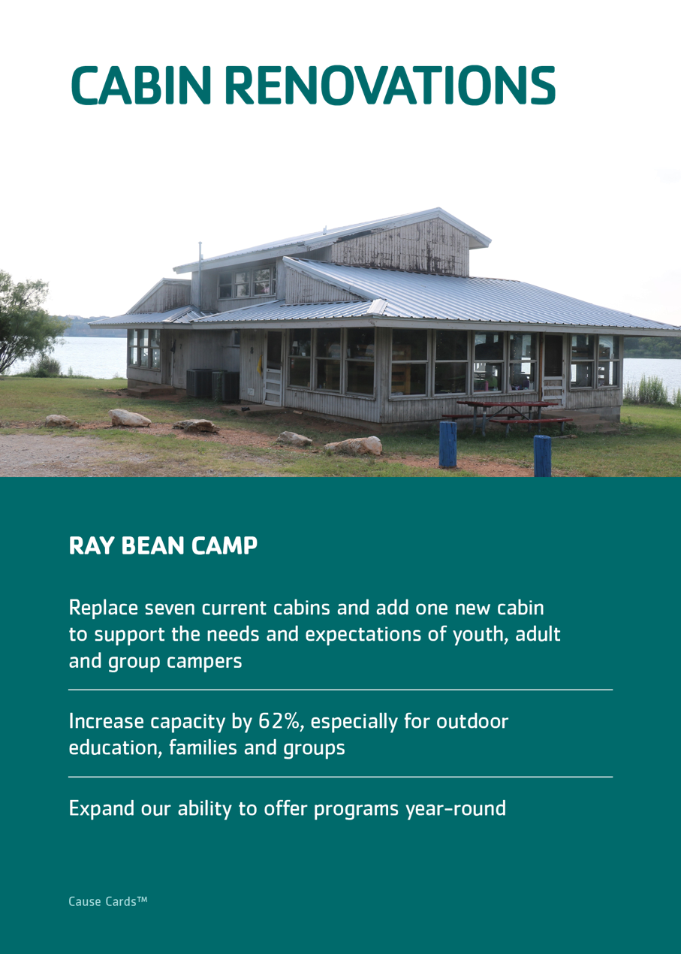

Slide 5
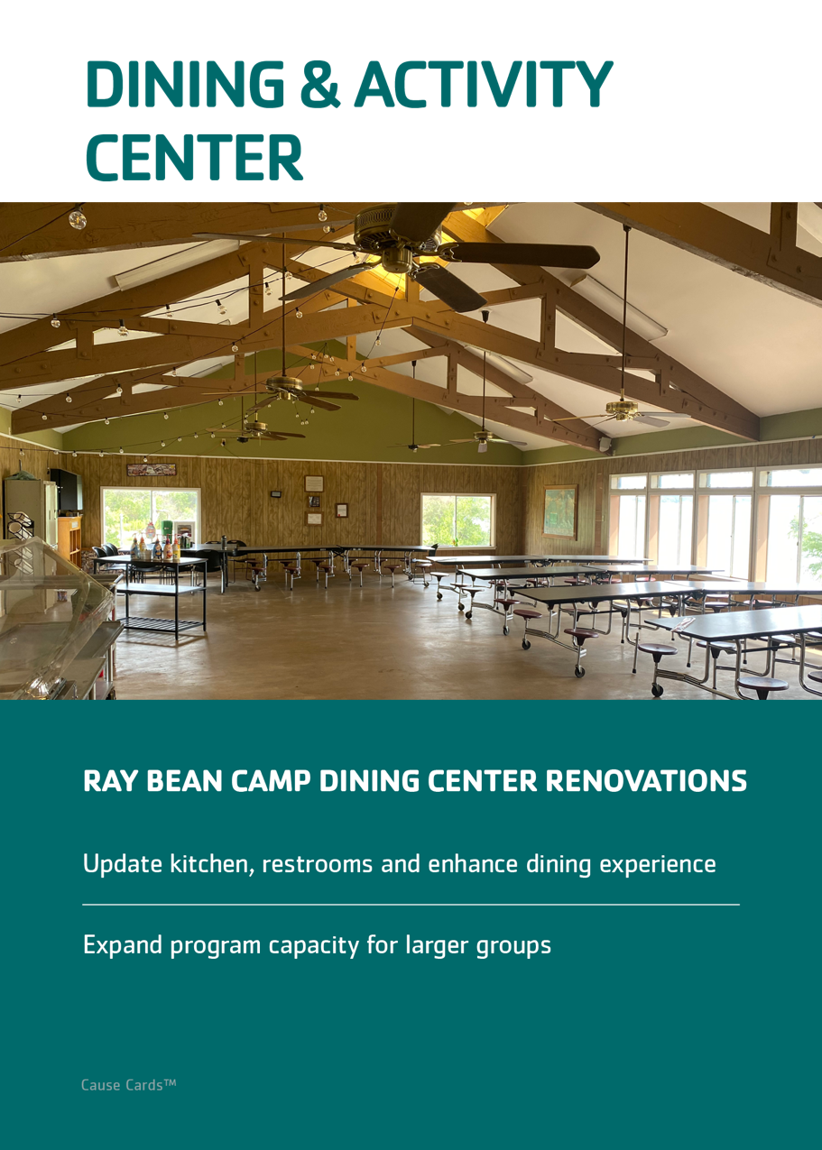

Slide 6
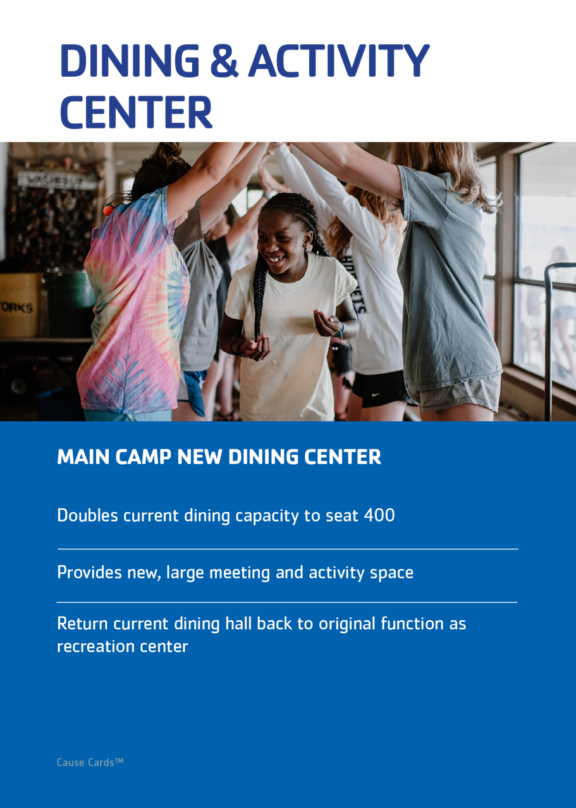

Slide 7
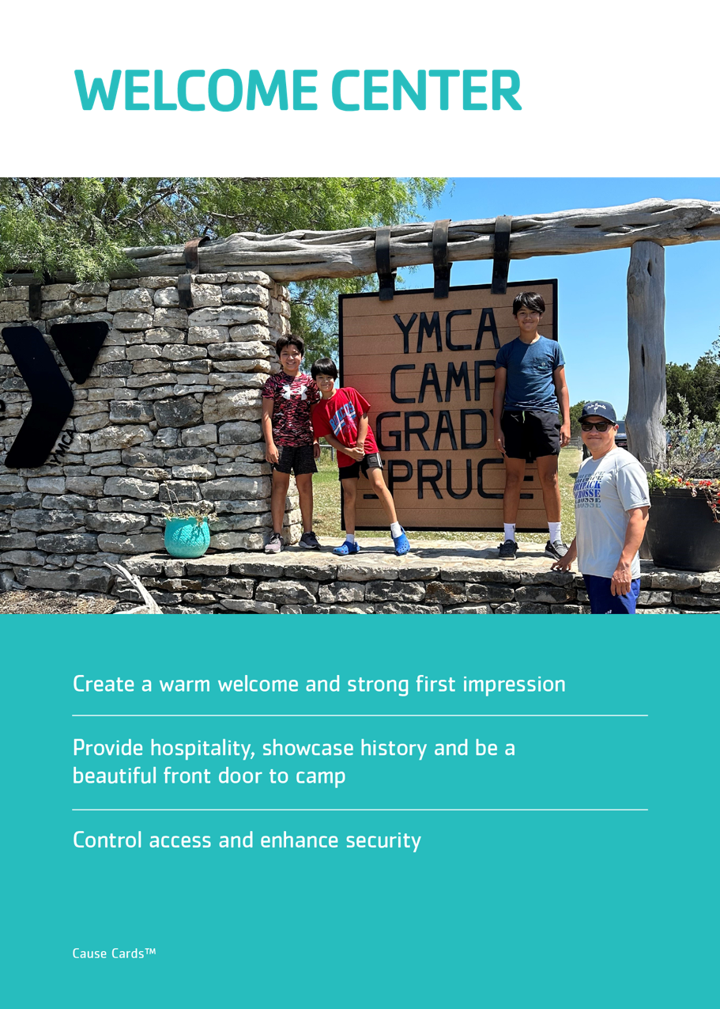

Slide 8
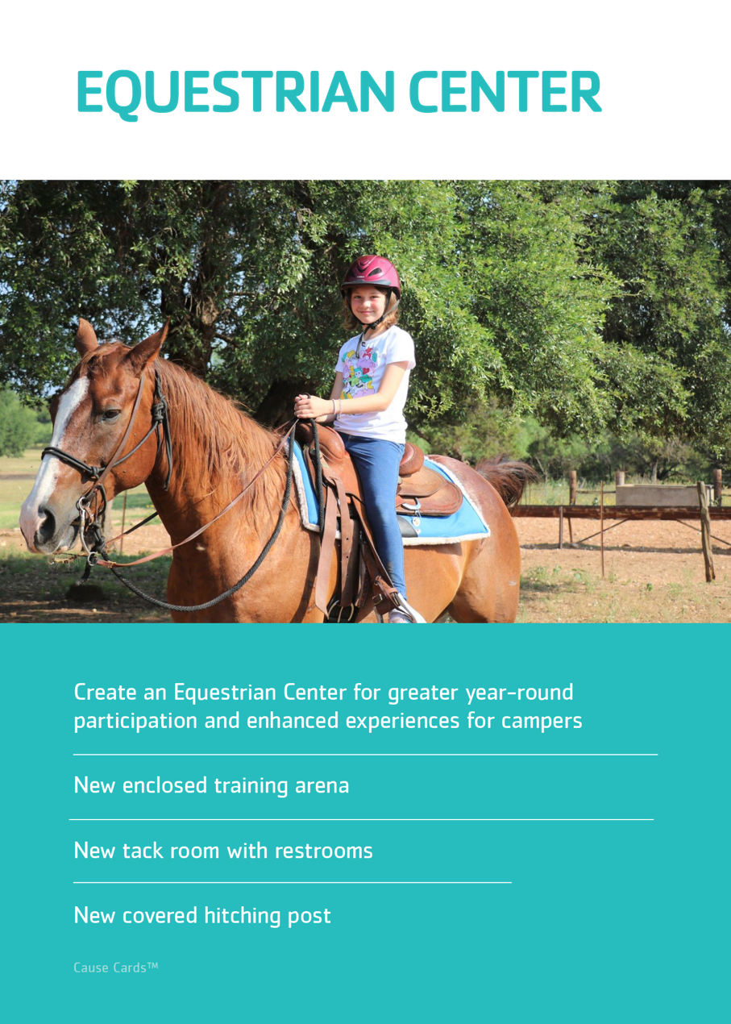

Slide 10
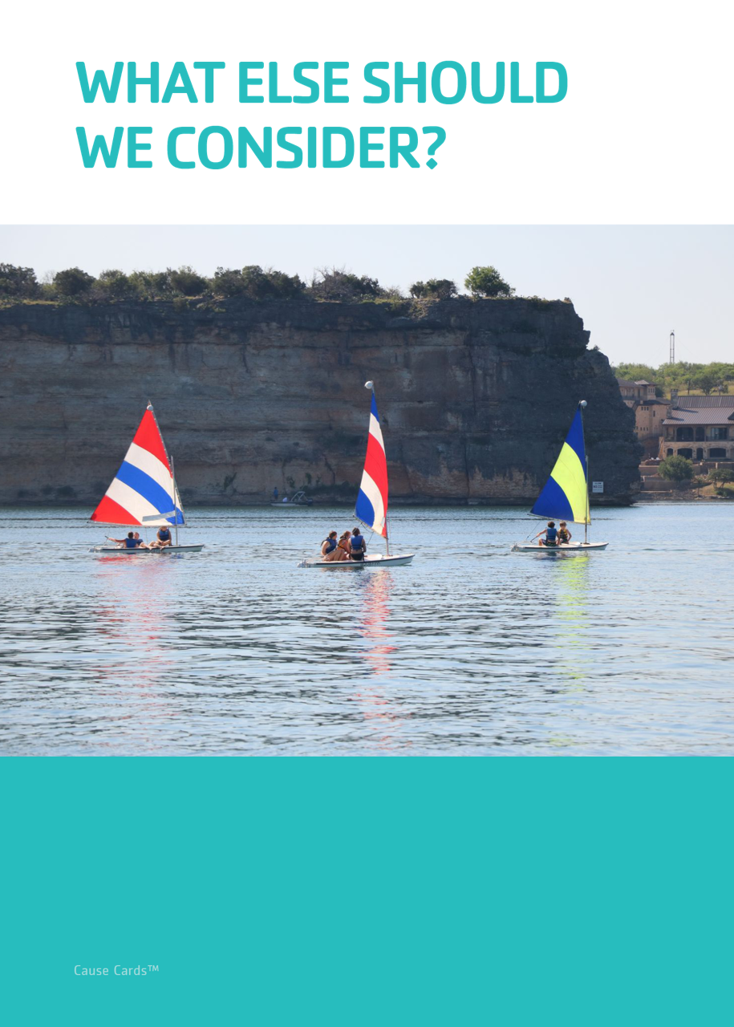

Slide 11
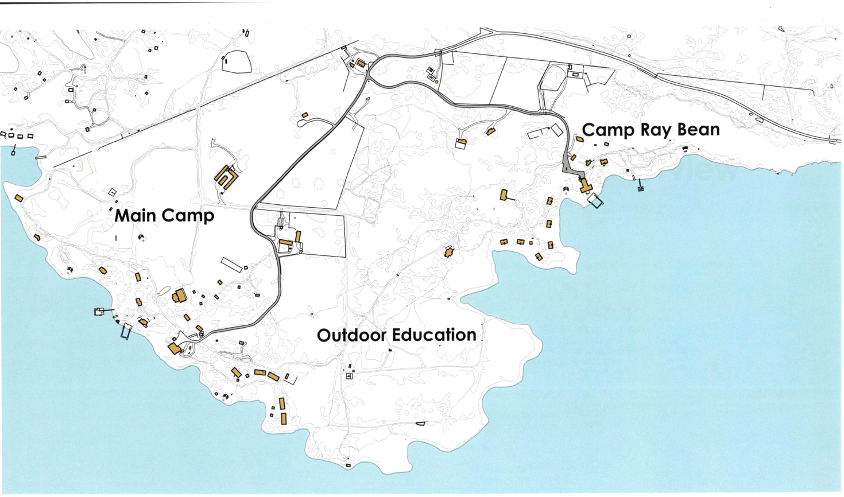

Slide 12
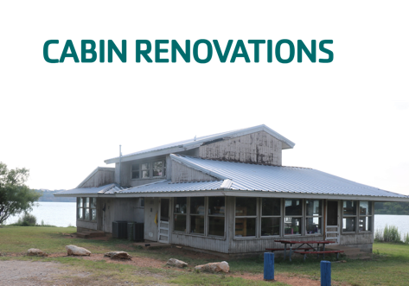
Notes:
RANKING. Since there are so few, you can either just do it verbally or re-arrange them on the screen.

Slide 13
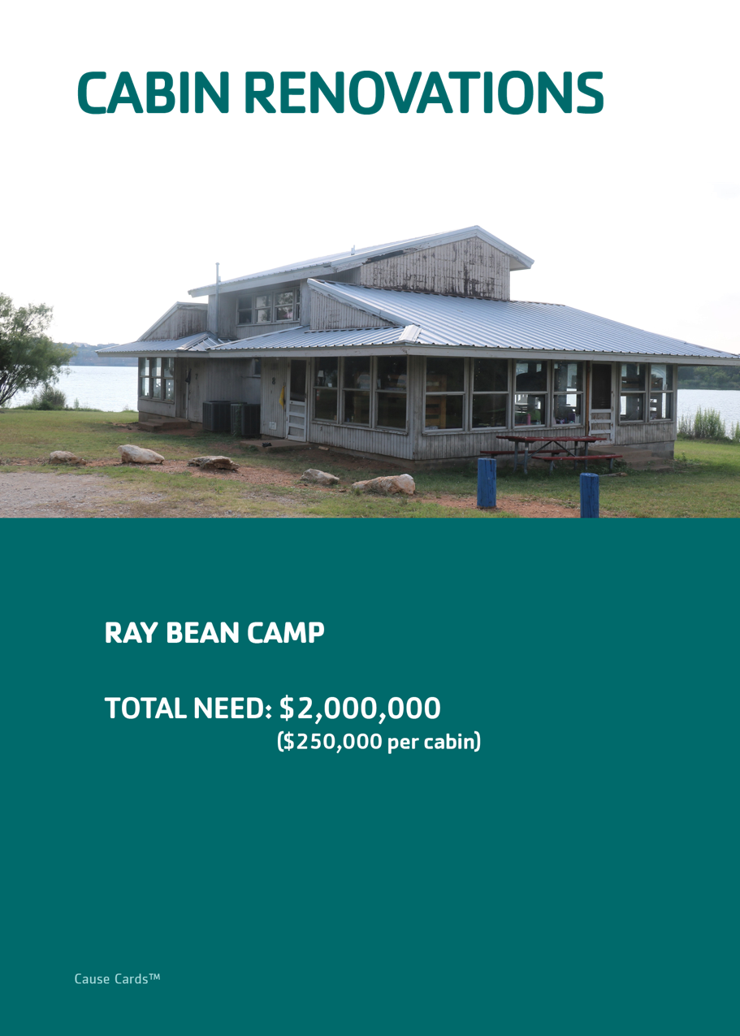

Slide 14
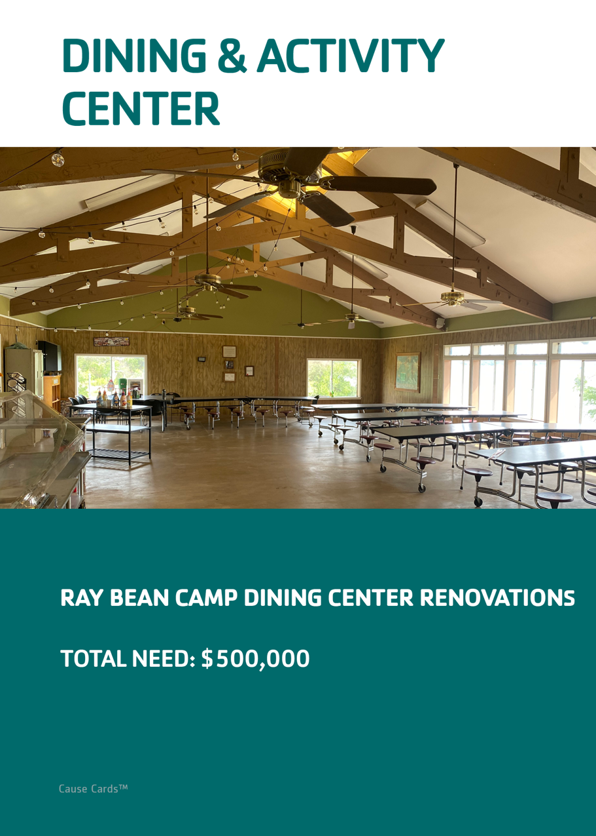
Notes:
You don’t have to use these. You could go straight to the campaign summary

Slide 16
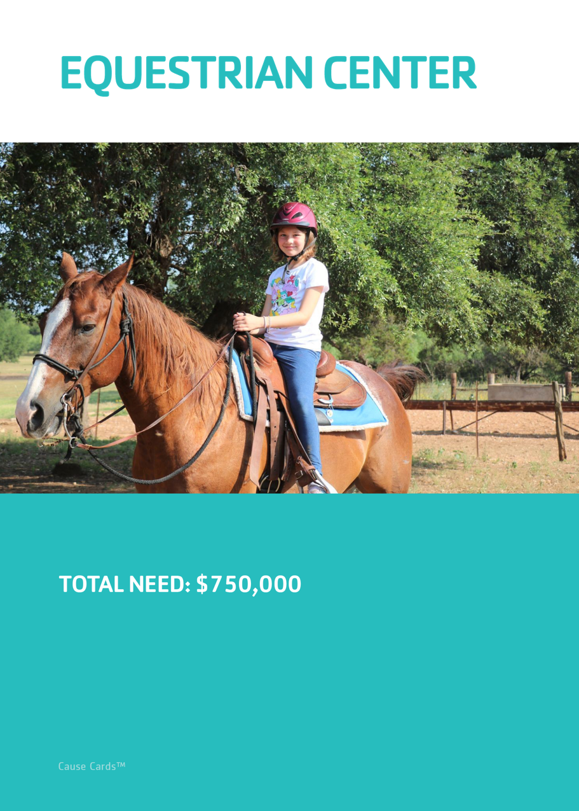

Slide 17
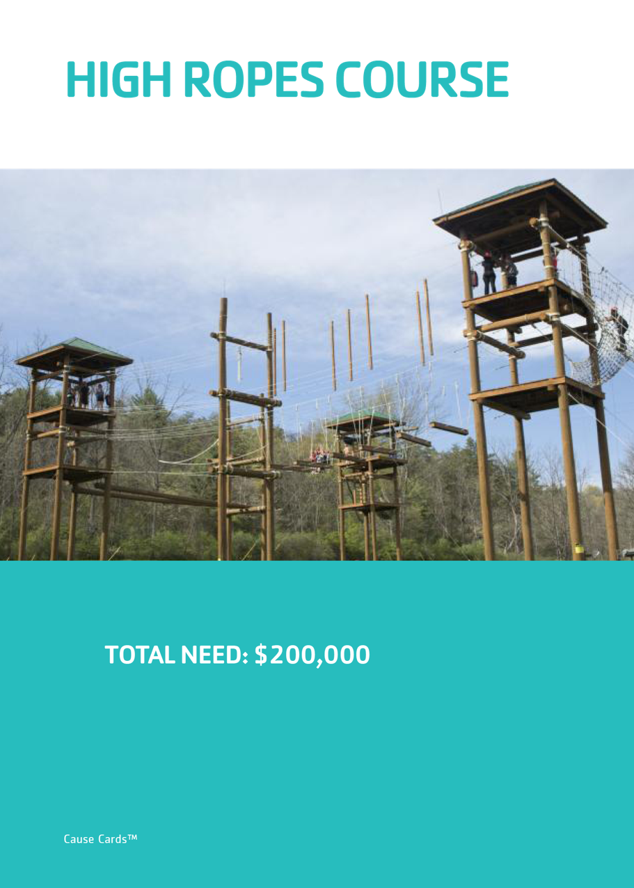

Slide 18
Notes:
RANKING. DOES THIS CHANGE YOUR RANKING?

Slide 19
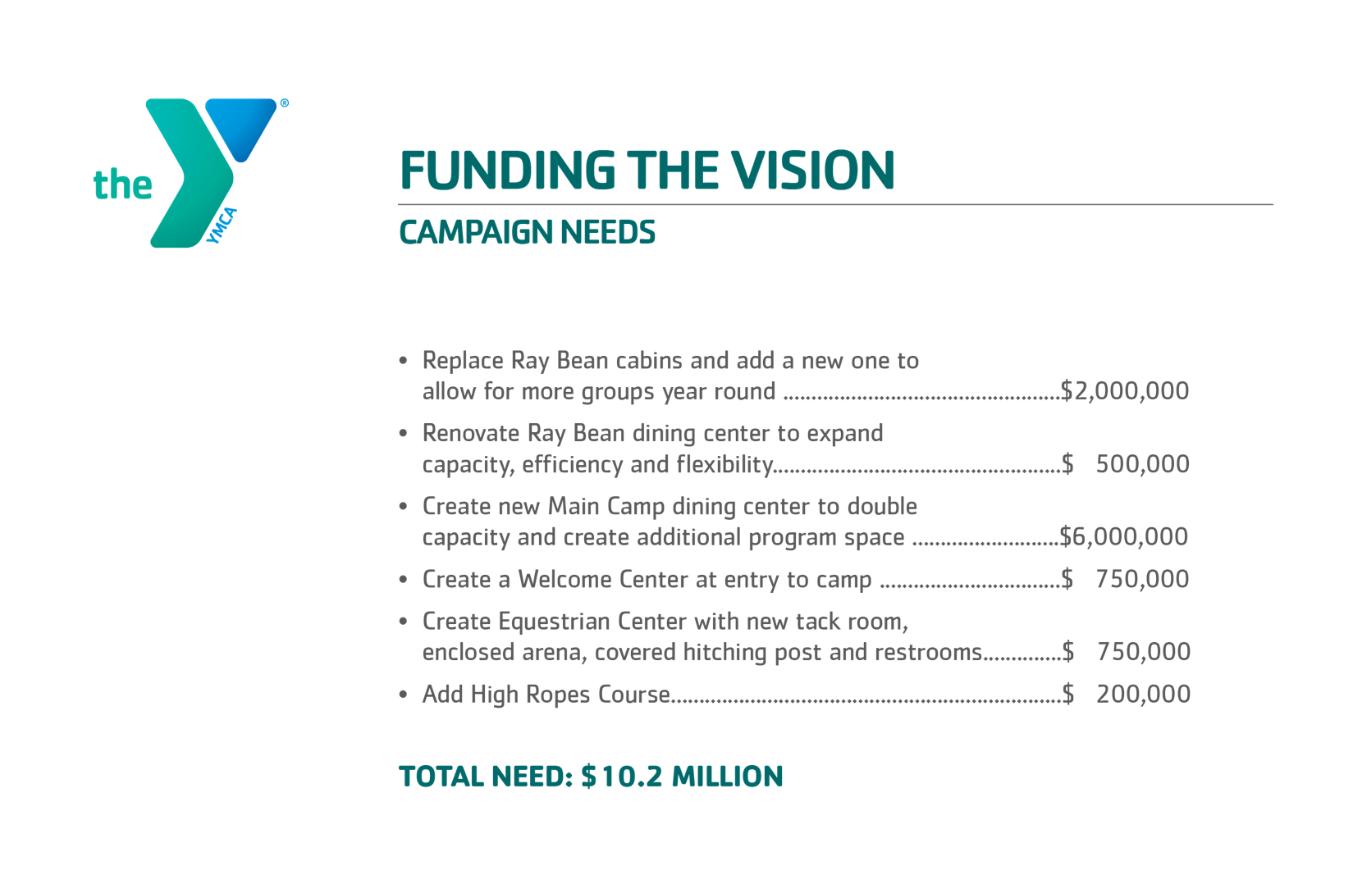

Slide 20
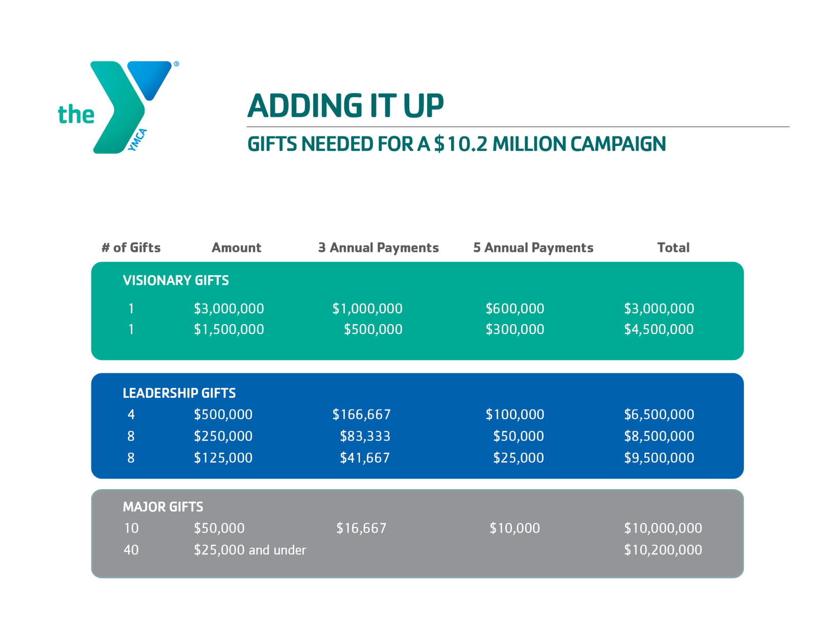
Notes:
DETERMINE WHETHER OR NOT TO USE THIS

Slide 22
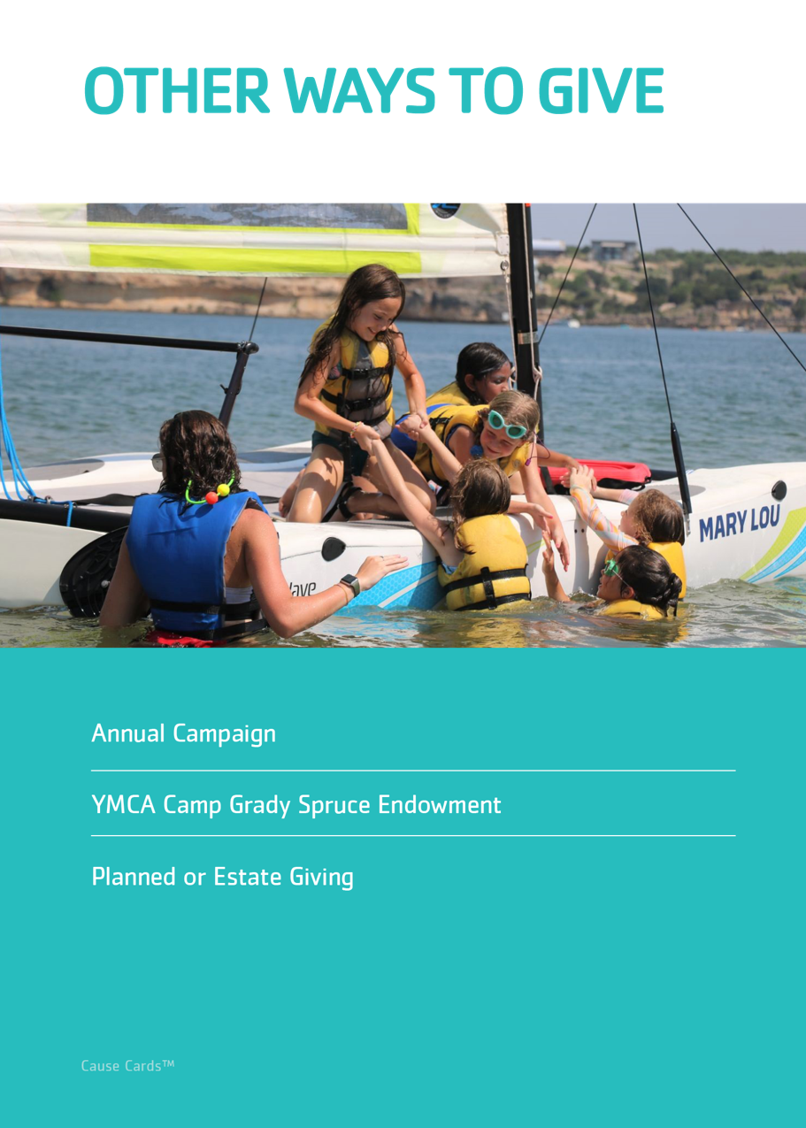

Slide 23
Feasibility Study
Fall 2023

